Slide 1
God Connecting People for the Gospel’s Advancement
Romans 16: 1 – 27

Slide 2
Questions
When was the last time you read out a list of names of people whom you recognize as those who have helped you in your spiritual growth?
When was the last time you connected with them?

Slide 3
Review

Slide 4
Romans 1 – 11
Doctrine of Salvation
Man’s Unrighteousness and God’s Judgment
Redemption and Justification by Faith
Living by the Spirit vs the Flesh
Salvation for Jews

Slide 5
Romans 12
“Therefore” in verse 1 connects the preceding chapters
Believers are to have right response after having understood the Gospel more fully.
Do not be conformed to the world but be transformed by the renewing of your mind
Re-focusing your thoughts on godly & biblical attitudes and values
Think from a Christian perspective

Slide 6
Romans 12 – 16: The Gospel Lived Out
God’s righteousness grasped & expressed in His people’s lives
In Personal Consecration (12: 1 – 2)
In Serving through Spiritual Gifts (12: 3 – 8)
How they relate to Society (12: 9 – 21)
… to the Government (13: 1 – 14)
… to Other Believers … especially the weak (14: 1 – 15:13)
In Appreciative Recognition of Others (16)

Slide 7
God Connecting People for the Gospel’s Advancement
Romans 16: 1 – 27

Slide 8

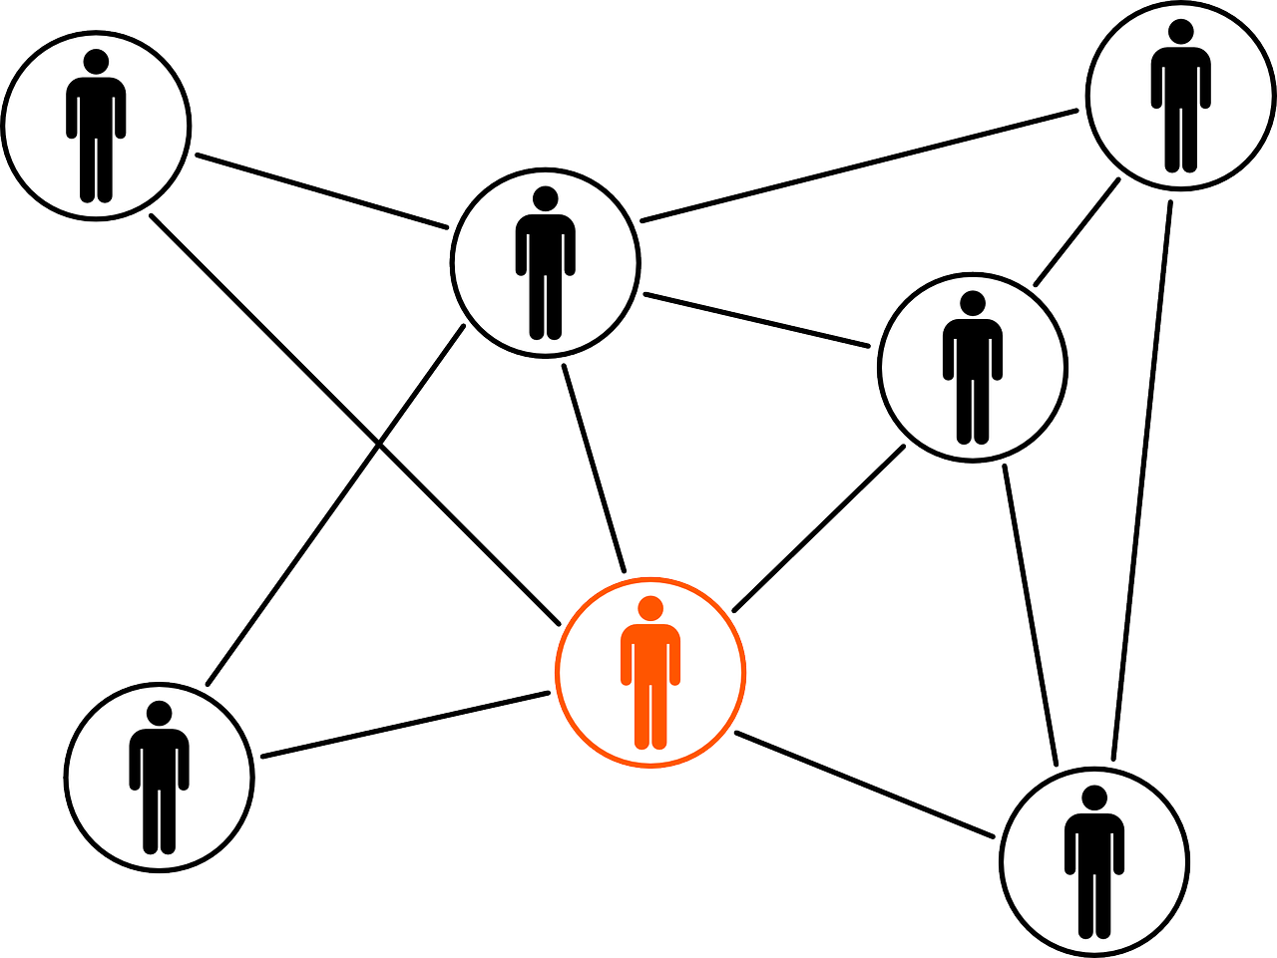
Big idea
God connects people to Paul to support and encourage him for the advancement of the Gospel

Slide 9
Outline
Paul and the People of the Gospel (1 – 16, 21 – 24)
Paul and the Perversion of the Gospel (17 – 19)
Paul and the Promise of the Gospel (20)
Paul and the Power of the Gospel (25 – 27)

Slide 10
Paul and the People of the Gospel (1 – 16, 21 – 23)

Slide 11
Paul and the People of the Gospel
He is sending a special woman to the church in Rome (vv.1 – 2)
  Who she is: Phoebe, a godly servant of Christ
  Where is she from: the church in Cenchrea
  Why she is coming: to minister to the Roman church as she had done for her church
He sends a special welcome to the church in Rome (vv. 3 – 16, 21 – 24)
  Paul sends greetings to individuals (26??)
  Paul sends greetings from eight individuals

Slide 12
Personal Greetings
16 I commend to you our sister Phoebe, a servant^{[a]} of the church at Cenchreae, ² that you may welcome her in the Lord in a way worthy of the saints, and help her in whatever she may need from you, for she has been a patron of many and of myself as well.
³ Greet Prisca and Aquila, my fellow workers in Christ Jesus, ⁴ who risked their necks for my life, to whom not only I give thanks but all the churches of the Gentiles give thanks as well.
⁵ Greet also the church in their house.
Greet my beloved Epaenetus, who was the first convert^{[b]} to Christ in Asia.
⁶ Greet Mary, who has worked hard for you.
⁷ Greet Andronicus and Junia,^{[c]} my kinsmen and my fellow prisoners. They are well known to the apostles,^{[d]} and they were in Christ before me.
⁸ Greet Ampliatus, my beloved in the Lord.
⁹ Greet Urbanus, our fellow worker in Christ, and my beloved Stachys.

Slide 13
Personal Greetings
¹⁰ Greet Apelles, who is approved in Christ. Greet those who belong to the family of Aristobulus.
¹¹ Greet my kinsman Herodion. Greet those in the Lord who belong to the family of Narcissus.
¹² Greet those workers in the Lord, Tryphaena and Tryphosa.
Greet the beloved Persis, who has worked hard in the Lord.
¹³ Greet Rufus, chosen in the Lord; also his mother, who has been a mother to me as well.
¹⁴ Greet Asyncritus, Phlegon, Hermes, Patrobas, Hermas, and the brothers^{[e]} who are with them.
¹⁵ Greet Philologus, Julia, Nereus and his sister, and Olympas, and all the saints who are with them.
¹⁶ Greet one another with a holy kiss. All the churches of Christ greet you.

Slide 14
Greetings from Paul’s co-workers
²¹ Timothy, my fellow worker, greets you; so do Lucius and Jason and Sosipater, my kinsmen.
²² I Tertius, who wrote this letter, greet you in the Lord.
²³ Gaius, who is host to me and to the whole church, greets you. Erastus, the city treasurer, and our brother Quartus, greet you.^{[g]}

Slide 15
Paul and the Perversion of the Gospel (17 – 19)
¹⁷ I appeal to you, brothers, to watch out for those who cause divisions and create obstacles contrary to the doctrine that you have been taught; avoid them.
¹⁸ For such persons do not serve our Lord Christ, but their own appetites,^{[f]} and by smooth talk and flattery they deceive the hearts of the naive.
¹⁹ For your obedience is known to all, so that I rejoice over you, but I want you to be wise as to what is good and innocent as to what is evil.
²⁰ The God of peace will soon crush Satan under your feet. The grace of our Lord Jesus Christ be with you.

Slide 16
Paul and the Perversion of the Gospel
Paul warns of some troublemakers in the Roman church (17 – 19)
What they are doing (v.17)
  Causing divisions (v.17a)
  Teaching false doctrine (v.17b)
  Upsetting people’s faith (v.17c)
Why they are doing it (vv. 18 – 19)
  To gain money and power for themselves

Slide 17
Paul and the Promise of the Gospel
God will someday crush Satan under our feet (v. 20)
  ²⁰ The God of peace will soon crush Satan under your feet. The grace of our Lord Jesus Christ be with you. (some older mss omit verse 24)
  Genesis 3: 15I will put enmity between you and the woman,
  and between your offspring^{[a]} and her offspring;
  he shall bruise your head,
  and you shall bruise his heel.”

Slide 18
Paul and the Power of the Gospel
It has the power to strengthen saints (v.25a)
It has the power to save sinners (v.25b – 27)
Doxology
²⁵ Now to him who is able to strengthen you according to my gospel and the preaching of Jesus Christ, according to the revelation of the mystery that was kept secret for long ages ²⁶ but has now been disclosed and through the prophetic writings has been made known to all nations, according to the command of the eternal God, to bring about the obedience of faith— ²⁷ to the only wise God be glory forevermore through Jesus Christ! Amen.

Slide 19
Reflection
(1) In what ways is spirit of hospitality shown in BSC? To its members and to strangers?
(2) In what ways does BSC reflect the vision of the church implied in Romans 16?

Slide 20
Big idea
God connects people to Paul to support and encourage him for the advancement of the Gospel
Do you see god connecting you to others for the advancement of the Gospel?

