Slide 1
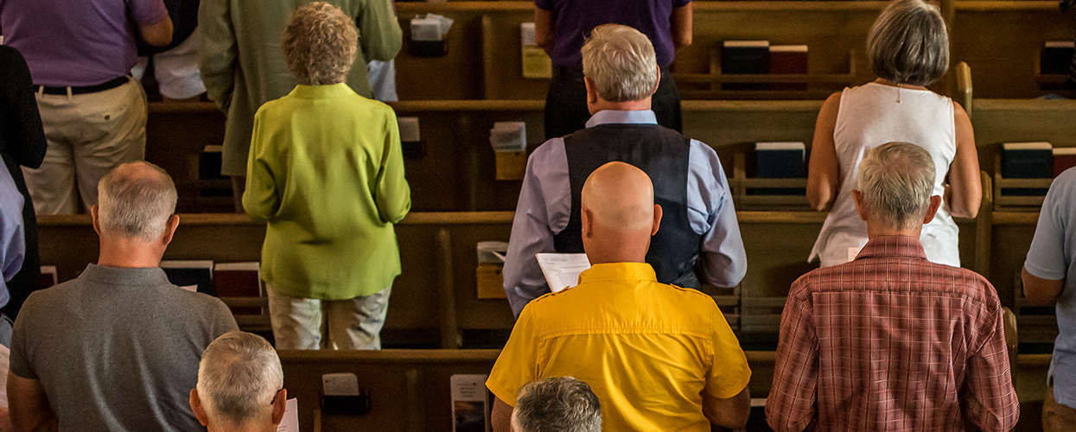
How does Gospel living look like?
Phil 2:19-30

Slide 2
An Overview
Phil 1:1-26 Paul rejoices over the church and in his own
imprisonment because of the work of the gospel
Phil 1:27-30 Paul urges the church to live a life worthy
of the gospel, in unity and humility
Phil 2:1-11 Paul explains how this gospel living is
exemplified and made possible by Jesus
Phil 2:12-18 Paul goes on to urge the church to work out the
implications of the gospel and live as lights
in the world
Phil 2:19-30 Paul now commends to the church, Timothy
and Epaphroditus, who are both examples
of what gospel living looks like

Slide 3
Phil 2:19-30
19 I hope in the Lord Jesus to send Timothy to you soon, so that I too
may be cheered by news of you. 20 For I have no one like him, who
will be genuinely concerned for your welfare. 21 They all seek their
own interests, not those of Jesus Christ. 22 But you know Timothy's
proven worth, how as a son with a father he has served with me in the
gospel. 23 I hope therefore to send him just as soon as I see how it will
go with me, 24 and I trust in the Lord that shortly I myself will come also.
25 I have thought it necessary to send to you Epaphroditus my brother
and fellow worker and fellow soldier, and your messenger and minister
to my need, 26 for he has been longing for you all and has been
distressed because you heard that he was ill. 27 Indeed he was ill,
near to death. But God had mercy on him, and not only on him but on
me also, lest I should have sorrow upon sorrow. 28 I am the more eager
to send him, therefore, that you may rejoice at seeing him again, and
that I may be less anxious. 29 So receive him in the Lord with all joy,
and honor such men, 30 for he nearly died for the work of Christ, risking
his life to complete what was lacking in your service to me.

Slide 4
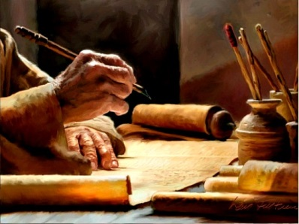
Phil 2:19-30
2. Timothy
Was with
Paul to
help him
1. Paul
Imprisoned
(under house
arrest) for
the gospel
5. Sending Epaphroditus
back to the Philippians
because of his health and
with his letter to them
6. Sending Timothy
to the Philippians
soon and will also
visit personally
upon release
4. Epaphroditus
Brought news of Philippians to Paul
(and probably became
very sick on the way)
3. Philippians
Sent Epaphroditus to help Paul and bring their gifts
Background of Philippians

Slide 5
Phil 2:19-30
19 I hope in the Lord Jesus to send Timothy to you soon, so that I too
may be cheered by news of you. 20 For I have no one like him, who
will be genuinely concerned for your welfare. 21 They all seek their
own interests, not those of Jesus Christ. 22 But you know Timothy's
proven worth, how as a son with a father he has served with me in the
gospel. 23 I hope therefore to send him just as soon as I see how it will
go with me, 24 and I trust in the Lord that shortly I myself will come also.
25 I have thought it necessary to send to you Epaphroditus my brother
and fellow worker and fellow soldier, and your messenger and
minister to my need, 26 for he has been longing for you all and has been
distressed because you heard that he was ill. 27 Indeed he was ill, near
to death. But God had mercy on him, and not only on him but on me also,
lest I should have sorrow upon sorrow. 28 I am the more eager to send
him, therefore, that you may rejoice at seeing him again, and that I may
be less anxious. 29 So receive him in the Lord with all joy, and honor
such men, 30 for he nearly died for the work of Christ, risking his life
to complete what was lacking in your service to me.

Slide 6

1. We share with
one another as
His family
c.f. 1 Tim 5:1-2
1 Do not rebuke
an older man but encourage him as you would a father. Treat younger men like brothers,
2 older women like mothers, younger women like sisters, in all purity.

Slide 7
Phil 2:19-30
19 I hope in the Lord Jesus to send Timothy to you soon, so that I too
may be cheered by news of you. 20 For I have no one like him, who
will be genuinely concerned for your welfare. 21 They all seek their
own interests, not those of Jesus Christ. 22 But you know Timothy's
proven worth, how as a son with a father he has served with me in the
gospel. 23 I hope therefore to send him just as soon as I see how it will
go with me, 24 and I trust in the Lord that shortly I myself will come also.
25 I have thought it necessary to send to you Epaphroditus my brother
and fellow worker and fellow soldier, and your messenger and minister
to my need, 26 for he has been longing for you all and has been
distressed because you heard that he was ill. 27 Indeed he was ill,
near to death. But God had mercy on him, and not only on him but on
me also, lest I should have sorrow upon sorrow. 28 I am the more eager
to send him, therefore, that you may rejoice at seeing him again, and
that I may be less anxious. 29 So receive him in the Lord with all joy,
and honor such men, 30 for he nearly died for the work of Christ, risking
his life to complete what was lacking in your service to me.

Slide 8
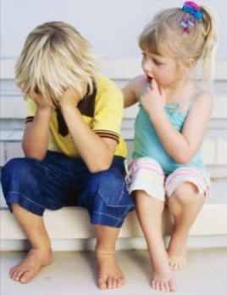
1. We share with
one another as
His family
c.f. 1 Tim 5:1-2
1 Do not rebuke
an older man but encourage him as you would a father. Treat younger men like brothers,
2 older women like mothers, younger women like sisters, in all purity.
caring for
and helping
one another

Slide 9
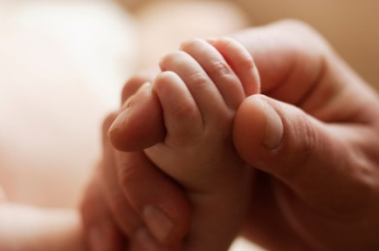
1. We share with
one another as
His family
Phil 2:19, 24, 27
19 I hope in the Lord Jesus to
send Timothy
to you soon…
24…I trust in
the Lord that shortly I myself
will come also
27…But God had mercy on him,
and not only on
him but on me
also, lest I should have sorrow upon sorrow
caring for
and helping
one another
trusting God (and praying) for one another
(doing too much vs. doing nothing)

Slide 10

2. We serve
the Lord as
His workers
c.f. 1 Cor 3:5,9
5 What then is Apollos? What is Paul? Servants through whom
you believed,
as the Lord
assigned to each.
9 For we are God's fellow workers.

Slide 11

2. We serve
the Lord as
His workers
Phil 2:21-23
21 They all seek their own interests, not those of Jesus Christ. 22 But you know Timothy's proven worth, how as a son with a father he has served with me in the gospel. 23 I hope therefore to send him just as soon as I see how it will go with me
serving the interests
of Jesus
(building
up)
(reaching
out)

Slide 12

2. We serve
the Lord as
His workers
being found impeccable and credible
serving the interests
of Jesus
(before
God)
(before
others)
(building
up)
(reaching
out)
Phil 2:20, 22 20 For I have no one like him...
22 But you know Timothy's proven worth...

Slide 13


Being Personal
1. We share with
one another as
His family
Being Purposeful
2. We serve
the Lord as
His workers
Motivation
and Focus:
God’s people
God’s Purpose

Slide 14
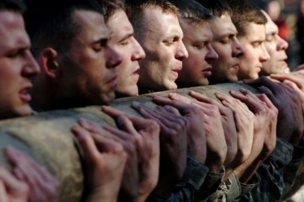
c.f. 2 Tim 2:3-4
3 Share in suffering as a good soldier of Christ Jesus.
4 No soldier gets entangled in civilian pursuits, since his aim
is to please the one who enlisted him.
3. We suffer
for the gospel
as His soldiers

Slide 15

c.f. 2 Tim 2:3-4
3 Share in suffering as a good soldier of Christ Jesus.
4 No soldier gets entangled in civilian pursuits, since his aim
is to please the one who enlisted him.
3. We suffer
for the gospel
as His soldiers
enduring hardship and staying faithful
Phil 2:29-30
29 So receive him in the Lord with all joy, and honor such men,
30 for he nearly died for the work of Christ, risking his life
to complete what was lacking in your service to me.

Slide 16

c.f. 2 Tim 2:3-4
3 Share in suffering as a good soldier of Christ Jesus.
4 No soldier gets entangled in civilian pursuits, since his aim
is to please the one who enlisted him.
3. We suffer
for the gospel
as His soldiers
enduring hardship and staying faithful
commending dedication
and effort
Motivation
and Focus:
God’s Pleasure
Phil 2:29
So receive him in the Lord with all joy, and honor such men,

Slide 17
Being Personal
(God’s People)
1. We share with
one another as
His family
How does
Gospel
living
look like?
Phil 2:19-30
Being Purposeful
(God’s Purpose)
2. We serve
the Lord as
His workers
3. We suffer
for the gospel
as His soldiers
Being Persevering
(God’s pleasure)
Phil 2:22
Timothy…how as a son with a father he has served with me in the gospel
Phil 2:25
…Epaphroditus my brother and fellow worker and fellow soldier

