Slide 1
Welcome to
Bethesda Serangoon Church
24 November 2019
Our Faith in God:
Yesterday, Today and Tomorrow
(Gen 12:1-4; Gen 22:1-3, 9-14)

Slide 2
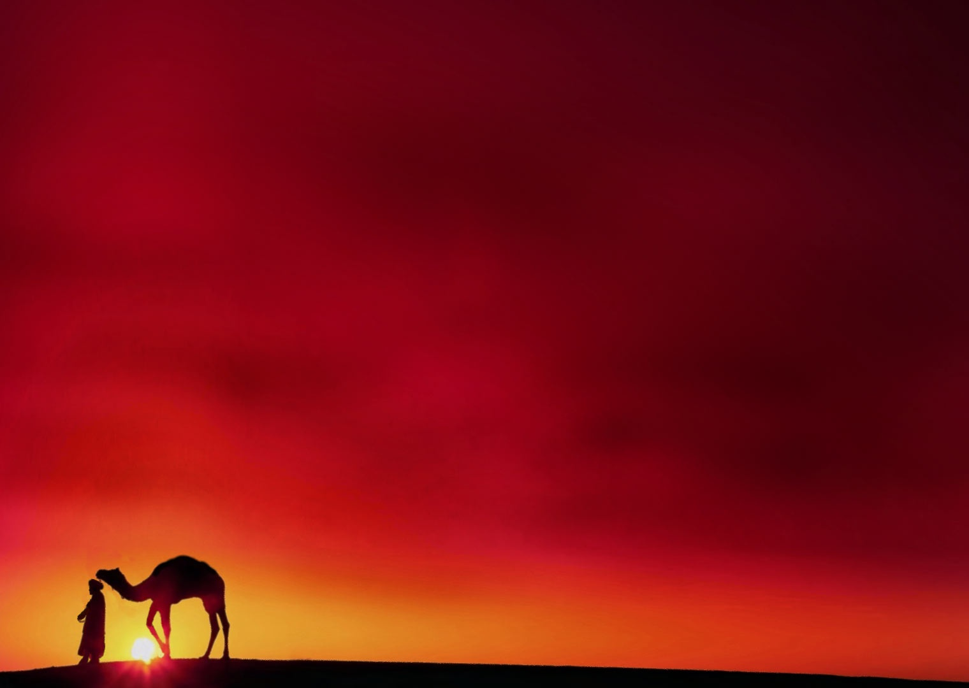
创世记 12:1-4
1耶和华对亚伯兰说：“你要离开本地、本族、父家，到我指示你的地方去。2 我必使你成为大国，
赐福给你，使你的名为大，你也必使别人得福，3 给你祝福的，我必赐福给他；咒诅你的，我必咒诅他；地上的万族，都必因你得福。” 4 亚伯兰就照着耶和华吩咐他的去了；罗得也和他同去。亚伯兰离开哈兰的时候，已经七十五岁。

Slide 3
创世记 22:1-3, 9-14
¹ 这些事以后，神试验亚伯拉罕，对他说：“亚伯拉罕啊！”他回答：“我在这里。” ² 神说：“带着你的儿子，就是你所爱的独生子以撒，到摩利亚地去，在我所要指示你的一座山上，把他献为燔祭。” ³ 亚伯拉罕清早起来，预备好了驴，带着两个童仆和自己的儿子以撒，也劈好了献燔祭用的柴，就起程到神指示他的地方去。 … ⁹ 他们到了神指示他的地方，亚伯拉罕就在那里筑了一座祭坛，摆好了柴，捆绑了自己的儿子以撒，就把他放在祭坛的柴上。 ¹⁰ 亚伯拉罕伸手拿刀，要宰杀自己的儿子的时候，¹¹ 耶和华的使者从天上呼叫亚伯拉罕，说：“亚伯拉罕，亚伯拉罕！”亚伯拉罕回答：“我在这里。” ¹² 天使说：“不可在这孩子身上下手，一点也不可害他；现在我知道你是敬畏神的了，因为你没有留下你的儿子、你的独生子不给我。” ¹³ 亚伯拉罕举目观望，看见在后面有一只公绵羊，两角扣在稠密的小树丛中；亚伯拉罕就去取了那只公绵羊，把牠献为燔祭，代替自己的儿子。 ¹⁴ 亚伯拉罕给那地方起名叫“耶和华以勒”。直到今日，人还说：“在耶和华的山上必有预备。”

Slide 4
What is faith?
Hebrews 11:1
Now faith is the assurance of things hoped for, the conviction of things not seen.

Slide 5

1. Faith of Yesterday

Slide 6
1. Faith of Yesterday
2. Faith of Tomorrow

Slide 7
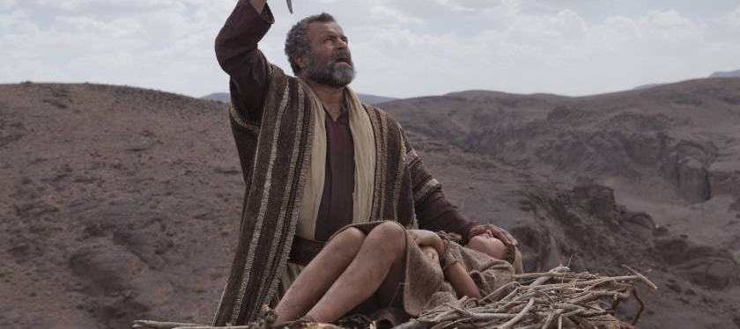
Gen 12 at Haran
Difference between the two tests that Abraham faced in his Faith of Yesterday and of Tomorrow
Gen 22 at Moriah

Slide 8
1. Faith of Yesterday
2. Faith of Tomorrow
3. Faith of Today

Slide 9
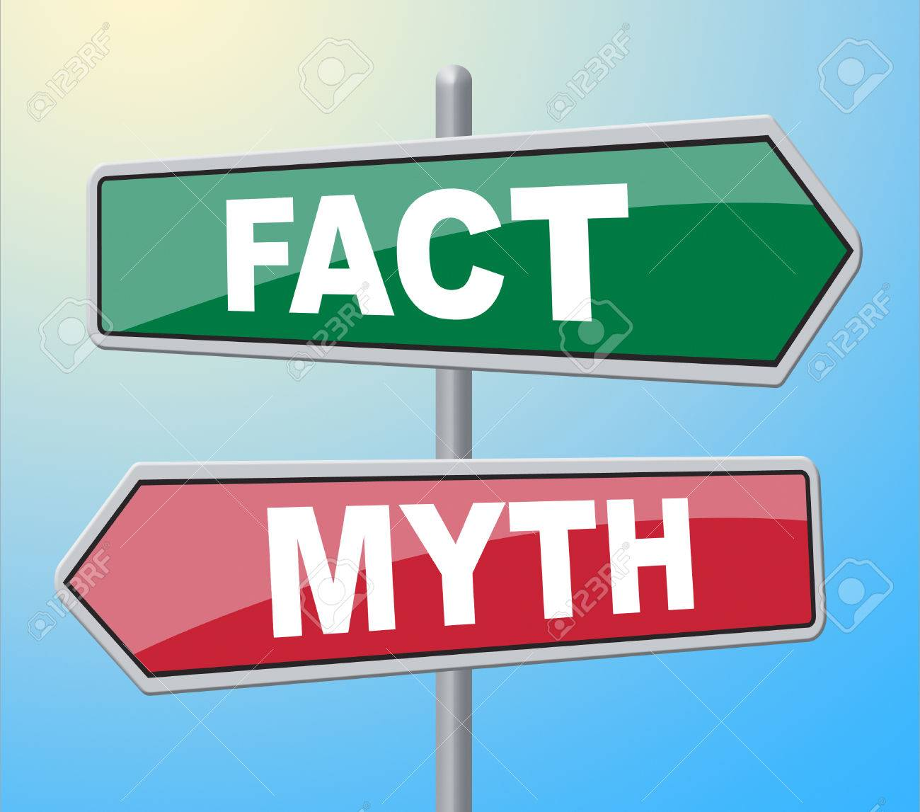
Myths of Faith versus Facts of Faith

Slide 10
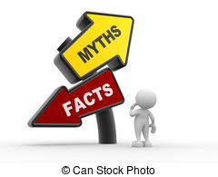
#1
“My faith can grow without trials.”
Myth or Fact?

Slide 11
Myth #1
“My faith can grow without trials.”
    Fact #1
    Faith can grow in the crucible and fire of life.
    (1 Cor 10:13)

Slide 12
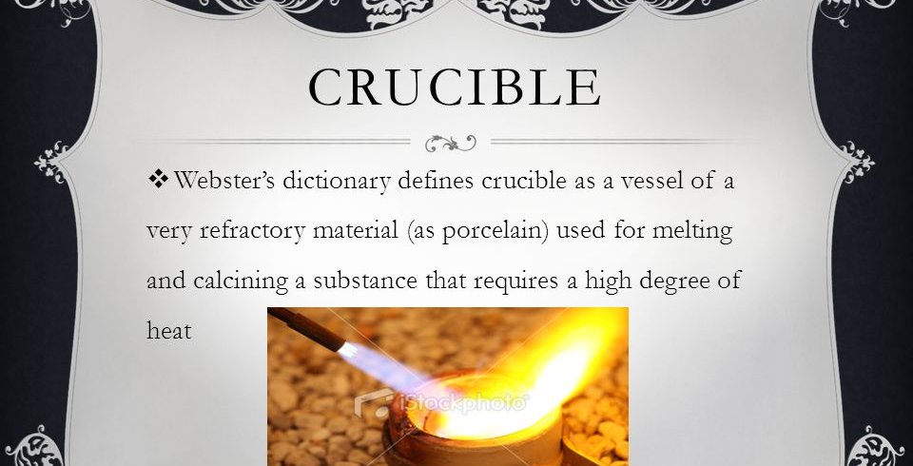

Slide 13
1 Corinthians 10:13
¹³ No temptation has overtaken you but such as is common to man; and God is faithful, who will not allow you to be tempted beyond what you are able, but with the temptation will provide the way of escape also, so that you will be able to endure it.
哥林多前书 10:13
¹³ 你们所受的试探，无非是人受得起的；神是信实的，他必不容许你们受试探过于你们承受得起的，而且在受试探的时候，必定给你们开一条出路，使你们能忍受得住。

Slide 14
#2
“I help God carry out
His will for me using
my own way.”
Myth or Fact?

Slide 15
Myth #2
“I help God carry out His will for me using my own way.”

Slide 16
Genesis 15:2-3
² Abram said, “O Lord God, what will You give me, since I am childless, and the heir of my house is Eliezer of Damascus?” ³ And Abram said, “Since You have given no offspring to me, one born in my house is my heir.”
创世记 15:2-3
² 亚伯兰说：“主耶和华啊，我一向都没有孩子，你还能赐给我甚么呢？这样，承受我家业的，就是大马士革人以利以谢了。” ³ 亚伯兰又说：“你既然没有给我后裔，那生在我家中的人，就是我的继承人了。”

Slide 17
Genesis 15:4-6
⁴ Then behold, the word of the Lord came to him, saying, “This man will not be your heir; but one who will come forth from your own body, he shall be your heir.” ⁵ And He took him outside and said, “Now look toward the heavens, and count the stars, if you are able to count them.” And He said to him, “So shall your descendants be.” ⁶ Then he believed in the Lord; and He reckoned it to him as righteousness.
创世记 15:4-6
⁴ 耶和华的话又临到亚伯兰说：“这人必不会作你的继承人；你亲生的才会是你的继承人。” ⁵ 于是领他到外面去，说：“你向天观看，数点众星，看你能不能把它们数得清楚。”又对他说：“你的后裔将要这样众多。” ⁶ 亚伯兰信耶和华，耶和华就以此算为他的义了。

Slide 18
Genesis 16:1-2
¹ Now Sarai, Abram’s wife had borne him no children, and she had an Egyptian maid whose name was Hagar. ² So Sarai said to Abram, “Now behold, the Lord has prevented me from bearing children. Please go in to my maid; perhaps I will obtain children through her.” And Abram listened to the voice of Sarai.
创世记 16:1-2
¹ 亚伯兰的妻子撒莱，没有为他生孩子。撒莱却有一个婢女，是埃及人，名叫夏甲。 ² 撒莱对亚伯兰说：“请看，耶和华使我不能生育，求你去亲近我的婢女，或者我可以从她得孩子。”亚伯兰就听从了撒莱的话。

Slide 19
Myth #2
“I help God carry out His will for me using my own way.”
    Fact #2
    Whatever that is not of faith is sin.
    (Rom 14:23b)

Slide 20
Myths of Faith versus Facts of Faith
Myth #1:
“My faith can grow without trials.”
      Fact #1:
      Faith can grow in the crucible and fire of life.(1 Cor 10:13)
Myth #2:
“I help God carry out His will for me using my own way.”
      Fact #2:
      Whatever that is not of faith is sin.
      (Rom 14:23b)

Slide 21
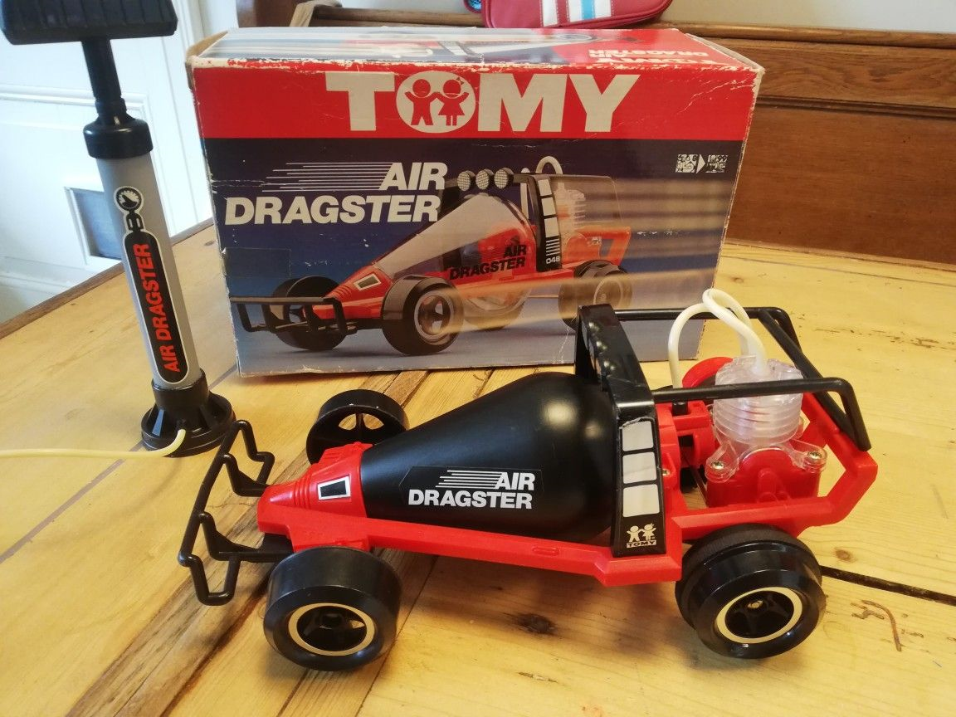
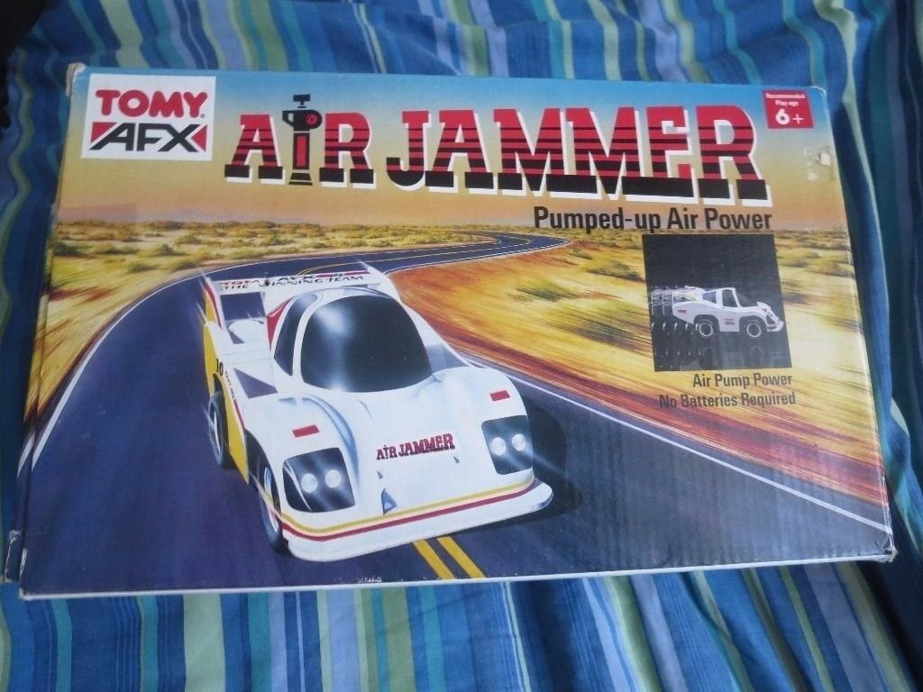

Slide 22
Hebrews 11:6
And without faith it is impossible to please Him, for he who comes to God must believe that He is and that He is a rewarder of those who seek Him.
希伯来书 11:6
没有信，就不能得到神的喜悦；因为来到神面前的人，必须信神存在，并且信他会赏赐那些寻求他的人。

Slide 23
Personal Reflection and Prayer
“Faith can grow in the crucible and fire of life.”
  How does this fact of fact explain a loving God allowing evil and suffering in contrary to some churches that teach about prosperity gospel (health and wealth)? Pray and ask God for His grace and strength if you are going through some testing in your faith at this moment in your life.
“Whatever that is not of faith is sin.”
  Was there any time in your life that you have succumbed to the world or your own way of doing things that was not pleasing to God. Acknowledge and confess this sin to God.
Are you facing any challenge that is coming your way tomorrow? How do the two facts of faith encourage you to persevere in doing the will of God His way and not your way?

