Slide 1
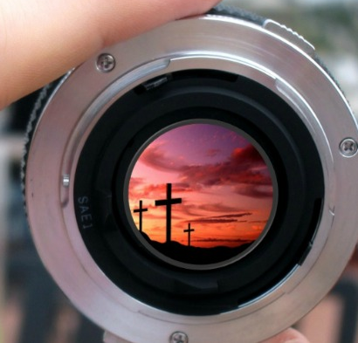
What is Our Focus?
Mark 6:30-44

Slide 2
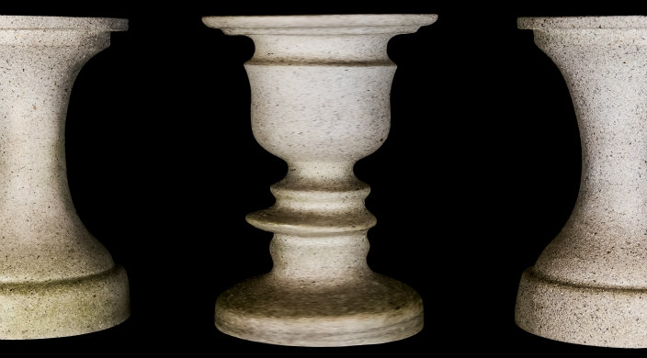
Rubin Vase

Slide 3

Rubin Vase

Slide 4
Rubin Vase

Slide 5
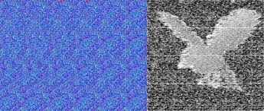
Auto-
stereogram
Seeing
3D images
by focusing on 2D patterns
Image of Eagle

Slide 6
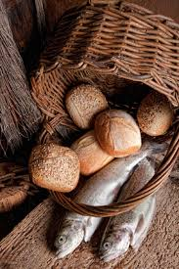
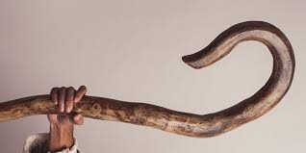
Setting:
Jesus feeds the 5000
(c.f. Matt 14, Luke 9, John 6)
Theme:
Jesus is powerful & loving

Slide 7
30 The apostles gathered around Jesus
& reported to him all they had done & taught.
c.f. 6:7, 12-13
7 Calling the Twelve to him, he sent them out two by two
& gave them authority over evil spirits…12 They went out &
preached that people should repent. 13 They drove out many
demons & anointed many sick people with oil & healed them.
31 Then, because so many people were coming & going that
they did not even have a chance to eat, he said to them,
"Come with me by yourselves to a quiet place & get some rest."
32 So they went away by themselves in a boat to a solitary place.
33 But many who saw them leaving recognized them & ran
on foot from all the towns & got there ahead of them.

Slide 8
35 By this time it was late in the day, so his disciples came to him.
"This is a remote place," they said, "& it's already very late.
36 Send the people away so they can go to the surrounding
countryside & villages & buy themselves something to eat."
37 But he answered, "You give them something to eat."
They said to him, "That would take eight months of a man's wages!
Are we to go & spend that much on bread & give it to them to eat?"
38 "How many loaves do you have?" he asked. "Go & see."
When they found out, they said, "Five (loaves) - & two fish."
39 Then Jesus directed them to have all the people sit down in groups on the green grass. 40 So they sat down in groups of hundreds & fifties.

Slide 9
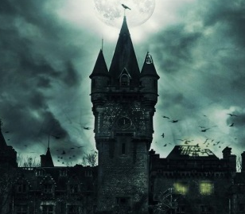

34 When Jesus landed & saw a large crowd, he had compassion
on them, because they were like sheep without a shepherd.
So he began teaching them many things.
41 Taking the five loaves & the two fish & looking up to heaven,
he gave thanks & broke the loaves. Then he gave them to his disciples
to set before the people. He also divided the two fish among them all.
42 They all ate & were satisfied, 43 & the disciples picked up
twelve basketfuls of broken pieces of bread & fish. 44 The number
of the men who had eaten was five thousand.
Theme:
Jesus is powerful & loving

Slide 10
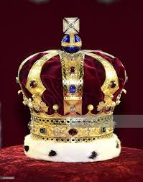
34 When Jesus landed & saw a large crowd, he had compassion
on them, because they were like sheep without a shepherd.
So he began teaching them many things.
41 Taking the five loaves & the two fish & looking up to heaven,
he gave thanks & broke the loaves. Then he gave them to his disciples
to set before the people. He also divided the two fish among them all.
42 They all ate & were satisfied, 43 & the disciples picked up
twelve basketfuls of broken pieces of bread & fish. 44 The number
of the men who had eaten was five thousand.
Theme:
Jesus is powerful & loving

Slide 11
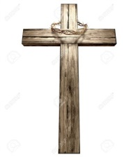

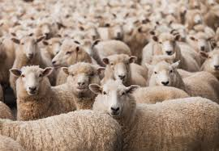


1. Change Our Focus
We can focus too much
on ourselves

Slide 12
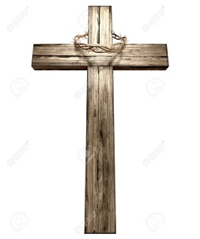


1. Change Our Focus
We can focus too much
on ourselves

Slide 13
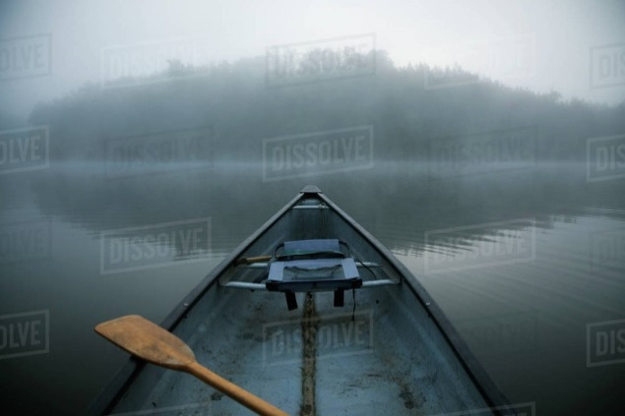
Part 1:
Jesus feeds
the 5000
(Mk 6:30-44)
Part 2:
Jesus calms
the wind
(Mk 6:45-52)

Slide 14
c.f. Mark 6:45-52
45 Immediately Jesus made his disciples get into the boat &
go on ahead of him to Bethsaida, while he dismissed the crowd.

Slide 15
c.f. Mark 6:45-52
45 Immediately Jesus made his disciples get into the boat &
go on ahead of him to Bethsaida, while he dismissed the crowd.
46 After leaving them, he went up on a mountainside to pray.
47 When evening came, the boat was in the middle of the lake, & he was alone on land. 48 He saw the disciples straining at the oars, because the wind was against them. About the fourth watch of the night he went
out to them, walking on the lake. He was about to pass by them,
49 but when they saw him walking on the lake, they thought he was
a ghost. They cried out, 50 because they all saw him & were terrified.
Immediately he spoke to them & said, "Take courage! It is I.
Don't be afraid." 51 Then he climbed into the boat with them, &
the wind died down. They were completely amazed, 52 for they
had not understood about the loaves; their hearts were hardened.

Slide 16
c.f. Mark 6:45-52
45 Immediately Jesus made his disciples get into the boat &
go on ahead of him to Bethsaida, while he dismissed the crowd.
46 After leaving them, he went up on a mountainside to pray.
47 When evening came, the boat was in the middle of the lake, & he was alone on land. 48 He saw the disciples straining at the oars, because the wind was against them. About the fourth watch of the night he went
out to them, walking on the lake. He was about to pass by them,
49 but when they saw him walking on the lake, they thought he was
a ghost. They cried out, 50 because they all saw him & were terrified.
Immediately he spoke to them & said, "Take courage! It is I.
Don't be afraid." 51 Then he climbed into the boat with them, &
the wind died down. They were completely amazed, 52 for they
had not understood about the loaves; their hearts were hardened.

Slide 17
c.f. Mark 6:45-52
45 Immediately Jesus made his disciples get into the boat &
go on ahead of him to Bethsaida, while he dismissed the crowd.
46 After leaving them, he went up on a mountainside to pray.
47 When evening came, the boat was in the middle of the lake, & he was alone on land. 48 He saw the disciples straining at the oars, because the wind was against them. About the fourth watch of the night he went
out to them, walking on the lake. He was about to pass by them,
49 but when they saw him walking on the lake, they thought he was
a ghost. They cried out, 50 because they all saw him & were terrified.
Immediately he spoke to them & said, "Take courage! It is I.
Don't be afraid." 51 Then he climbed into the boat with them, &
the wind died down. They were completely amazed, 52 for they
had not understood about the loaves; their hearts were hardened.

Slide 18
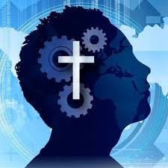
2. Check Our Focus
Reflect on what
Christ has done

Slide 19
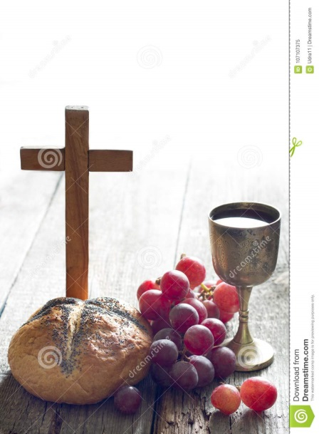
Part 1:
Jesus feeds
the 5000
(Mk 6:30-44)
Part 3:
Jesus explains
the miracle
(Jn 6:46-51)
Part 2:
Jesus calms
the wind
(Mk 6:45-52)

Slide 20
c.f. John 6:22-27
22 The next day the crowd that had stayed on the opposite
shore of the lake realized that only one boat had been there,
& that Jesus had not entered it with his disciples, but that they had
gone away alone. 23 Then some boats from Tiberias landed near
the place where the people had eaten the bread after the Lord had
given thanks. 24 Once the crowd realized that neither Jesus nor
his disciples were there, they got into the boats & went to
Capernaum in search of Jesus.

Slide 21
c.f. John 6:22-27
25 When they found him on the other side of the lake,
they asked him, "Rabbi, when did you get here?"
26 Jesus answered, "I tell you the truth, you are looking for me,
not because you saw miraculous signs but because you ate the
loaves & had your fill. 27 Do not work for food that spoils,
but for food that endures to eternal life, which the Son of Man will
give you. On him God the Father has placed his seal of approval."

Slide 22
c.f. John 6:46-51
46 No one has seen the Father except the one who is
from God; only he (Jesus) has seen the Father.
47 I tell you the truth, he who believes has everlasting life.
48 I am the bread of life. 49 Your forefathers ate the manna
in the desert, yet they died. 50 But here is the bread that comes
down from heaven, which a man may eat & not die.
51 I am the living bread that came down from heaven.
If anyone eats of this bread, he will live forever.
This bread is my flesh, which I will give
for the life of the world."

Slide 23
3. Christ is Our Focus
He is the Son of God
(who rules over us)
He's the Bread of Life
(who saves & gives us life)

Slide 25


Slide 26
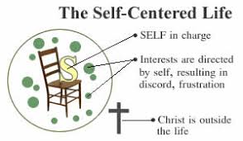
3. Christ is Our Focus
He is the Son of God
(who rules over us)
He's the Bread of Life
(who saves & gives us life)

Slide 27

1. Change
Our Focus
We can focus
too much
on ourselves
Our-selves

Slide 28
1. Change
Our Focus
2. Check
Our Focus
We can focus
too much
on ourselves
Reflect on
what Christ
has done
Christ
Our-
selves

Slide 29
1. Change
Our Focus
2. Check
Our Focus
3. Christ is
Our Focus
We can focus
too much
on ourselves
Reflect on
what Christ
has done
He is the
Son of God,
Bread of Life
Christ
Christ
Our-
selves
What am I most concerned about today?
How can I still stay sharply focussed on Jesus?

Slide 30
What is Our Focus?
(The Feeding of the 5000)
Mark 6:30-44
Setting:
Jesus feeds the 5000 (Matt 14, Luke 9, John 6)
Theme:
Jesus is powerful & loving
1. Change Our Focus
(Mark 6:30-44)
2. Check Our Focus
(c.f. Mark 6:45-52)
3. Christ is Our Focus
(c.f. John 6:46-51)
Questions for consideration:
What am I most concerned about today?
How can I still stay sharply focussed on Jesus?
What is Our Focus?
(The Feeding of the 5000)
Mark 6:30-44
Setting:
Jesus feeds the 5000 (Matt 14, Luke 9, John 6)
Theme:
Jesus is powerful & loving
1. Change Our Focus
We can focus too much on ourselves
2. Check Our Focus
Reflect (c.f. Mark 6:45-52)
3. Christ is Our Focus
He is the Son of God;
He's the Bread of Life (c.f. John 6:46-51)
Questions for consideration:
What am I most concerned about today?
How can I still stay sharply focussed on Jesus?

