Slide 1
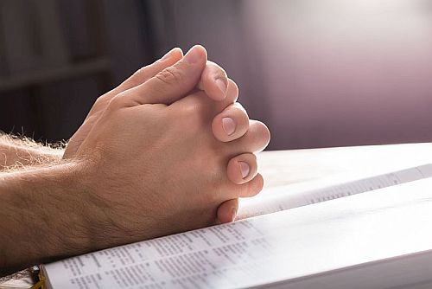
Learning to Pray:
…need to submit and
depend on God
Luke 11:1-28

Slide 2
What is Luke’s Gospel About?
Act 1:1 In the first book, O Theophilus, I have dealt with all that Jesus began to do and teach,
How was it written?
Luk 1:1 Inasmuch as many have undertaken to compile a narrative of the things that have been accomplished among us,
Luk 1:2 just as those who from the beginning were eyewitnesses and ministers of the word have delivered them to us,
Why Luke was written?
Luk 1:3 it seemed good to me also, having followed all things closely for some time past, to write an orderly account for you, most excellent Theophilus,
Luk 1:4 that you may have certainty concerning the things you have been taught.

Slide 3
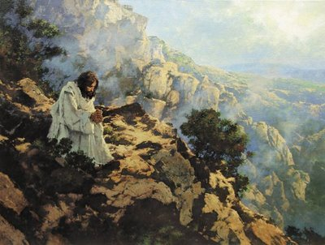
Luk_6:12 In these days he went out to the mountain to pray, and all night he continued in prayer to God.
Luk_9:28 Now about eight days after these sayings he took with him Peter and John and James and went up on the mountain to pray.

Slide 4
4/5 KEY PRINCIPLES OF PRAYER
In red: Matthew’s extended version
Luk 11:2 And he said to them, “When you pray, say:
*“Father,
*hallowed be your name.
*Your kingdom come.
Luk 11:3 Give us each day our daily bread,
Luk 11:4 and forgive us our sins, for we ourselves forgive everyone who is indebted to us.
And lead us not into temptation.”
Mat 6:9 After this manner therefore pray ye:
*Our Father which art in heaven, *Hallowed be thy name.
*Mat 6:10 Thy kingdom come. Thy will be done in earth, as it is in heaven.
Mat 6:11 Give us this day our daily bread.
Mat 6:12 And forgive us our debts, as we forgive our debtors.
Mat 6:13 And lead us not into temptation, but deliver us from evil:
For thine is the kingdom, and the power, and the glory, for ever. Amen.
PERSON
*Father
*Holy
*Sovereign
PROVISION
PARDON
PRESERVATION
PRAISE

Slide 5
Context of Luke’s Lord Prayer | Context of Matthew’s Lord’s Prayer
Where Luk 11:1 Now Jesus was praying in a certain place, and when he finished, Reason one of his disciples said to him, “Lord, teach us to pray, as John taught his disciples.” | Where Mat 5:1 Seeing the crowds, he went up on the mountain, and when he sat down, his disciples came to him. Mat 5:2 And he opened his mouth and taught them, saying: Reason Mat 6:1 “Beware of practicing your righteousness before other people in order to be seen by them, for then you will have no reward from your Father who is in heaven. Mat 6:5 “And when you pray, you must not be like the hypocrites. ….. Mat 6:9 Pray then like this: “Our Father in heaven, hallowed be your name.

Slide 6
A Discipleship Prayer: Luke 11:1
Now Jesus was praying in a certain place, and when he finished, one of his disciples said to him,
“Lord, teach us to pray,
as John taught his disciples.”

Slide 7
5 KEY PRINCIPLES OF PRAYER
In red: Matthew’s extended version
Luk 11:2 And he said to them, “When you pray, say:
*“Father,
*hallowed be your name.
*Your kingdom come.
Luk 11:3 Give us each day our daily bread,
Luk 11:4 and forgive us our sins, for we ourselves forgive everyone who is indebted to us.
And lead us not into temptation.”
Mat 6:9 After this manner therefore pray ye:
*Our Father which art in heaven, *Hallowed be thy name.
*Mat 6:10 Thy kingdom come. Thy will be done in earth, as it is in heaven.
Mat 6:11 Give us this day our daily bread.
Mat 6:12 And forgive us our debts, as we forgive our debtors.
Mat 6:13 And lead us not into temptation, but deliver us from evil:
For thine is the kingdom, and the power, and the glory, for ever. Amen.
PERSON
*Father
*Holy
*Sovereign
PROVISION
PARDON
PRESERVATION
PRAISE

Slide 8
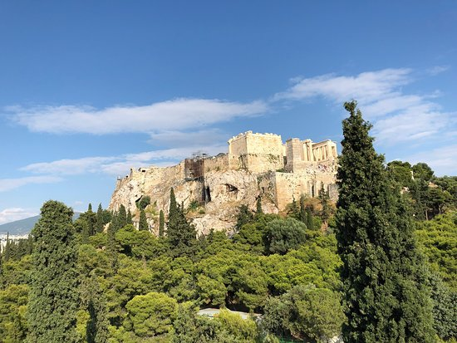
Act 17:22 So Paul, standing in the midst of the Areopagus, said: “Men of Athens, I perceive that in every way you are very religious.
Act 17:23 For as I passed along and observed the objects of your worship, I found also an altar with this inscription: ‘To the unknown god.’ What therefore you worship as unknown, this I proclaim to you.
Act 17:27 that they should seek God, and perhaps feel their way toward him and find him. Yet he is actually not far from each one of us,
Mars Hill Athens where St Paul preached

Slide 9
5 KEY PRINCIPLES OF PRAYER
In red: Matthew’s extended version
Luk 11:2 And he said to them, “When you pray, say:
*“Father,
*hallowed be your name.
*Your kingdom come.
Luk 11:3 Give us each day our daily bread,
Luk 11:4 and forgive us our sins, for we ourselves forgive everyone who is indebted to us.
And lead us not into temptation.”
Mat 6:9 After this manner therefore pray ye:
*Our Father which art in heaven,
*Hallowed be thy name.
*Mat 6:10 Thy kingdom come. Thy will be done in earth, as it is in heaven.
Mat 6:11 Give us this day our daily bread.
Mat 6:12 And forgive us our debts, as we forgive our debtors.
Mat 6:13 And lead us not into temptation, but deliver us from evil:
For thine is the kingdom, and the power, and the glory, for ever. Amen.
PERSON
*Father
*Holy
*Sovereign
PROVISION
PARDON
PRESERVATION
PRAISE

Slide 10
Hebrews 12:28
Therefore let us be grateful
for receiving a kingdom that cannot be shaken, and thus let us offer to God
acceptable worship,
with reverence and awe,
Hebrews 12:29
for our God is a consuming fire. (ESV)
Psa 139:23 ESV Search me, O God, and know my heart! Try me and know my thoughts!
Psa 139:24
And see if there be any grievous way in me, and lead me in the way everlasting!
Lev 10:1 And Nadab and Abihu, the sons of Aaron, took either of them his censer, and put fire therein, and put incense thereon, and offered strange fire before the LORD, which he commanded them not.
Lev 10:2 And there went out fire from the LORD, and devoured them, and they died before the LORD. (KJV)

Slide 11
5 KEY PRINCIPLES OF PRAYER
In red: Matthew’s extended version
Luk 11:2 And he said to them, “When you pray, say:
*“Father,
*hallowed be your name.
*Your kingdom come.
Luk 11:3 Give us each day our daily bread,
Luk 11:4 and forgive us our sins, for we ourselves forgive everyone who is indebted to us.
And lead us not into temptation.”
Mat 6:9 After this manner therefore pray ye:
*Our Father which art in heaven, *Hallowed be thy name.
*Mat 6:10 Thy kingdom come.
Thy will be done in earth, as it is
in heaven.
Mat 6:11 Give us this day our daily bread.
Mat 6:12 And forgive us our debts, as we forgive our debtors.
Mat 6:13 And lead us not into temptation, but deliver us from evil:
For thine is the kingdom, and the power, and the glory, for ever. Amen.
PERSON
*Father
*Holy
*Sovereign
PROVISION
PARDON
PRESERVATION
PRAISE

Slide 12
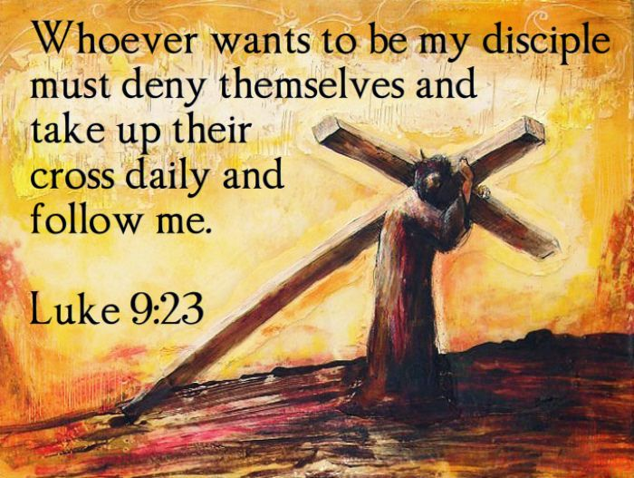

Slide 13
5 KEY PRINCIPLES OF PRAYER
In red: Matthew’s extended version
Luk 11:2 And he said to them, “When you pray, say:
*“Father,
*hallowed be your name.
*Your kingdom come.
Luk 11:3 Give us each day our daily bread,
Luk 11:4 and forgive us our sins, for we ourselves forgive everyone who is indebted to us.
And lead us not into temptation.”
PERSON
*Father
*Holy
*Sovereign
PROVISION
PARDON
PRESERVATION
PRAISE
Mat 6:9 After this manner therefore pray ye:
*Our Father which art in heaven, *Hallowed be thy name.
*Mat 6:10 Thy kingdom come. Thy will be done in earth, as it is in heaven.
Mat 6:11 Give us this day our daily bread.
Mat 6:12 And forgive us our debts, as we forgive our debtors.
Mat 6:13 And lead us not into temptation, but deliver us from evil:
For thine is the kingdom, and the power, and the glory, for ever. Amen.
Three Notes:
God cares for human needs
This day…our daily
Basic Bread

Slide 14
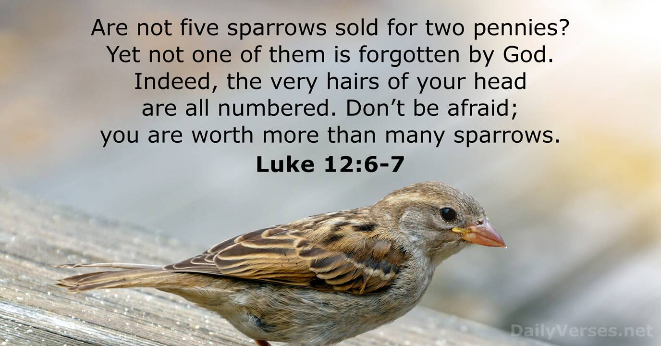
Our Worth in God’s Eyes

Slide 15
5 KEY PRINCIPLES OF PRAYER
In red: Matthew’s extended version
Luk 11:2 And he said to them, “When you pray, say:
*“Father,
*hallowed be your name.
*Your kingdom come.
Luk 11:3 Give us each day our daily bread,
Luk 11:4 and forgive us our sins, for we ourselves forgive everyone who is indebted to us.
And lead us not into temptation.”
PERSON
*Father
*Holy
*Sovereign
PROVISION
PARDON
PRESERVATION
PRAISE
Mat 6:9 After this manner therefore pray ye:
*Our Father which art in heaven, *Hallowed be thy name.
*Mat 6:10 Thy kingdom come. Thy will be done in earth, as it is in heaven.
Mat 6:11 Give us this day our daily bread.
Mat 6:12 And forgive us our debts, as we forgive our debtors.
Mat 6:13 And lead us not into temptation, but deliver us from evil:
For thine is the kingdom, and the power, and the glory, for ever. Amen.
Three Notes:
God cares for human needs
This day…our daily
Basic Bread

Slide 16
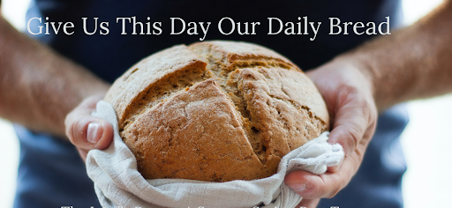
Luke 11:3
“Give us each day our daily bread”
“Dependence on God for needs is a daily exercise, and we should mainly ask for the needs of today. We are not to worry about the needs of the next day or the next week, month or years!”
Joh 6:27
Do not work for the food that perishes, but for the food that endures to eternal life

Slide 17
5 KEY PRINCIPLES OF PRAYER
In red: Matthew’s extended version
Luk 11:2 And he said to them, “When you pray, say:
*“Father,
*hallowed be your name.
*Your kingdom come.
Luk 11:3 Give us each day our daily bread,
Luk 11:4 and forgive us our sins, for we ourselves forgive everyone who is indebted to us.
And lead us not into temptation.”
PERSON
*Father
*Holy
*Sovereign
PROVISION
PARDON
PRESERVATION
PRAISE
Mat 6:9 After this manner therefore pray ye:
*Our Father which art in heaven, *Hallowed be thy name.
*Mat 6:10 Thy kingdom come. Thy will be done in earth, as it is in heaven.
Mat 6:11 Give us this day our daily bread.
Mat 6:12 And forgive us our debts, as we forgive our debtors.
Mat 6:13 And lead us not into temptation, but deliver us from evil:
For thine is the kingdom, and the power, and the glory, for ever. Amen.
God cares for human needs
This day…our daily
Basic Bread

Slide 18
5 KEY PRINCIPLES OF PRAYER
In red: Matthew’s extended version
Luk 11:2 And he said to them, “When you pray, say:
*“Father,
*hallowed be your name.
*Your kingdom come.
Luk 11:3 Give us each day our daily bread,
Luk 11:4 and forgive us our sins, for we ourselves forgive everyone who is indebted to us.
And lead us not into temptation.”
PERSON
*Father
*Holy
*Sovereign
PROVISION
PARDON
PRESERVATION
PRAISE
Mat 6:9 After this manner therefore pray ye:
*Our Father which art in heaven, *Hallowed be thy name.
*Mat 6:10 Thy kingdom come. Thy will be done in earth, as it is in heaven.
Mat 6:11 Give us this day our daily bread.
Mat 6:12 And forgive us our debts, as we forgive our debtors.
Mat 6:13 And lead us not into temptation, but deliver us from evil:
For thine is the kingdom, and the power, and the glory, for ever. Amen.

Slide 19
5 KEY PRINCIPLES OF PRAYER
In red: Matthew’s extended version
Luk 11:2 And he said to them, “When you pray, say:
*“Father,
*hallowed be your name.
*Your kingdom come.
Luk 11:3 Give us each day our daily bread,
Luk 11:4 and forgive us our sins, for we ourselves forgive everyone who is indebted to us.
And lead us not into temptation.”
PERSON
*Father
*Holy
*Sovereign
PROVISION
PARDON
PRESERVATION
PRAISE
Mat 6:9 After this manner therefore pray ye:
*Our Father which art in heaven, *Hallowed be thy name.
*Mat 6:10 Thy kingdom come. Thy will be done in earth, as it is in heaven.
Mat 6:11 Give us this day our daily bread.
Mat 6:12 And forgive us our debts, as we forgive our debtors.
Mat 6:13 And lead us not into temptation, but deliver us from evil:
For thine is the kingdom, and the power, and the glory, for ever. Amen.

Slide 20
Mat 6:13
And lead us not into temptation,
but deliver us from evil
(1)To be delivered from the temptation of unforgiveness:
Eph 6:12
For we do not wrestle against flesh and blood, but against the rulers, against the authorities, against the cosmic powers over this present darkness, against the spiritual forces of evil in the heavenly places.
(2)To be delivered from the temptation of the world:
1Jn 2:16 For all that is in the world—the desires of the flesh and the desires of the eyes and pride of life—is not from the Father but is from the world.

Slide 21
5 KEY PRINCIPLES OF PRAYER
In red: Matthew’s extended version
Luk 11:2 And he said to them, “When you pray, say:
*“Father,
*hallowed be your name.
*Your kingdom come.
Luk 11:3 Give us each day our daily bread,
Luk 11:4 and forgive us our sins, for we ourselves forgive everyone who is indebted to us.
And lead us not into temptation.”
PERSON
*Father
*Holy
*Sovereign
PROVISION
PARDON
PRESERVATION
PRAISE
Mat 6:9 After this manner therefore pray ye:
*Our Father which art in heaven, *Hallowed be thy name.
*Mat 6:10 Thy kingdom come. Thy will be done in earth, as it is in heaven.
Mat 6:11 Give us this day our daily bread.
Mat 6:12 And forgive us our debts, as we forgive our debtors.
Mat 6:13 And lead us not into temptation, but deliver us from evil:
For thine is the kingdom, and the power, and the glory, for ever. Amen.

Slide 22
“Praising and submitting to God in all His Person conclude and affirm God as the right focus of our prayer, it is not about ourselves. It confirms our need to live for God even in asking for daily bread, in seeking forgiveness and to be delivered from evil. Whatever God’s answers to our prayers are, we accept that He is Sovereign and all things must work towards His Kingdom, and for the good of them who love God.”

Slide 23
3 Aspects of Prayer in Luke 11:1-28
1. 5 Key Principles in guiding Prayer Content 11:1-4 2. One Specific Principle in Praying for Needs 11:5-13
11:3, ”Give us each day our daily bread”
Luk 11:5 And he said to them, “Which of you who has a friend will go to him at midnight and say to him, ‘Friend, lend me three loaves, Luk 11:6 for a friend of mine has arrived on a journey, and I have nothing to set before him’; Luk 11:7 and he will answer from within, ‘Do not bother me; the door is now shut, and my children are with me in bed. I cannot get up and give you anything’?
Luk 11:8 I tell you, though he will not get up and give him anything because he is his friend, yet because of his impudence he will rise and give him whatever he needs.
Luk 11:9 And I tell you, ask, and it will be given to you; seek, and you will find; knock, and it will be opened to you. Luk 11:10 For everyone who asks receives, and the one who seeks finds, and to the one who knocks it will be opened.
Luk 11:11 What father among you, if his son asks for a fish, will instead of a fish give him a serpent; Luk 11:12 or if he asks for an egg, will give him a scorpion?
Luk 11:13 If you then, who are evil, know how to give good gifts to your children, how much more will the heavenly Father give the Holy Spirit to those who ask him!”

Slide 24
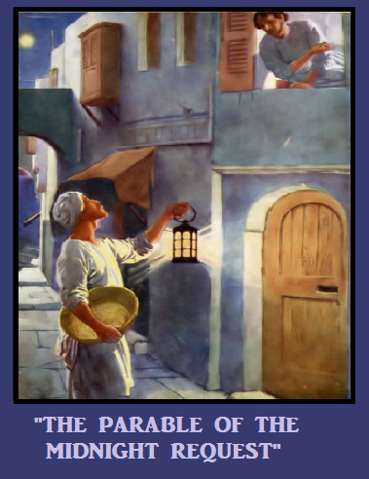
Luk 11:5 And he said to them, “Which of you who has a friend will go to him at midnight and say to him, ‘Friend, lend me three loaves, Luk 11:6 for a friend of mine has arrived on a journey, and I have nothing to set before him’; Luk 11:7 and he will answer from within, ‘Do not bother me; the door is now shut, and my children are with me in bed. I cannot get up and give you anything’?
Luk 11:8 I tell you, though he will not get up and give him anything because he is his friend,
yet because of his impudence
he will rise and give him
whatever he needs.

Slide 25
Jesus’ point is that in praying for real needs and not just want, we have to exercise shameless persistency.
Moreover we are pleading with God who knows us, who cares, and who will never feel inconvenience.

Slide 26
3 Aspects of Prayer in Luke 11:1-28
1. 5 Key Principles in Guiding Prayer Content 11:1-4 2. One Specific Principle in Praying for Needs 11:5-13
One General Principle in Praying for Preservation 11:14-26
11:4, “And lead us not into temptation, but deliver us from evil”
Luk 11:14 Now he was casting out a demon that was mute. When the demon had gone out, the mute man spoke, and the people marveled. Luk 11:15 But some of them said, “He casts out demons by Beelzebul, the prince of demons,” Luk 11:16 while others, to test him, kept seeking from him a sign from heaven.
Luk 11:17 But he, knowing their thoughts, said to them, “Every kingdom divided against itself is laid waste, and a divided household falls. Luk 11:18 And if Satan also is divided against himself, how will his kingdom stand? For you say that I cast out demons by Beelzebul. Luk 11:19 And if I cast out demons by Beelzebul, by whom do your sons cast them out? Therefore they will be your judges. Luk 11:20 But if it is by the finger of God that I cast out demons, then the kingdom of God has come upon you. Luk 11:21 When a strong man, fully armed, guards his own palace, his goods are safe; Luk 11:22 but when one stronger than he attacks him and overcomes him, he takes away his armor in which he trusted and divides his spoil.
Luk 11:23 Whoever is not with me is against me, and whoever does not gather with me scatters.
Luk 11:24 “When the unclean spirit has gone out of a person, it passes through waterless places seeking rest, and finding none it says, ‘I will return to my house from which I came.’
Luk 11:25 And when it comes, it finds the house swept and put in order.
Luk 11:26 Then it goes and brings seven other spirits more evil than itself, and they enter and dwell there. And the last state of that person is worse than the first.”

Slide 27
Luk 11:4
and forgive us our sins, for we ourselves forgive everyone who is indebted to us
And lead us not into temptation.”
The consequence of not forgiving in God’s Church
Temptation of NOT Forgiving
2Co 2:10
Anyone whom you forgive, I also forgive. Indeed, what I have forgiven, if I have forgiven anything, has been for your sake in the presence of Christ,
2Co 2:11
that we would not be outwitted by Satan; for we are not ignorant of his designs.

Slide 28
3 Aspects of Prayer in Luke 11:1-28
1. 5 Key Principles in Guiding Prayer Content 11:1-4 2. One Specific Principle in Praying for Needs 11:5-13
One General Principle in Praying for Protection 11:14-26
11:4, “And lead us not into temptation, but deliver us from evil”
Luk 11:14 Now he was casting out a demon that was mute. When the demon had gone out, the mute man spoke, and the people marveled. Luk 11:15 But some of them said, “He casts out demons by Beelzebul, the prince of demons,” Luk 11:16 while others, to test him, kept seeking from him a sign from heaven.
Luk 11:17 But he, knowing their thoughts, said to them, “Every kingdom divided against itself is laid waste, and a divided household falls. Luk 11:18 And if Satan also is divided against himself, how will his kingdom stand? For you say that I cast out demons by Beelzebul. Luk 11:19 And if I cast out demons by Beelzebul, by whom do your sons cast them out? Therefore they will be your judges. Luk 11:20 But if it is by the finger of God that I cast out demons, then the kingdom of God has come upon you. Luk 11:21 When a strong man, fully armed, guards his own palace, his goods are safe; Luk 11:22 but when one stronger than he attacks him and overcomes him, he takes away his armor in which he trusted and divides his spoil.
Luk 11:23 Whoever is not with me is against me, and whoever does not gather with me scatters.
Luk 11:24 “When the unclean spirit has gone out of a person, it passes through waterless places seeking rest, and finding none it says, ‘I will return to my house from which I came.’
Luk 11:25 And when it comes, it finds the house swept and put in order.
Luk 11:26 Then it goes and brings seven other spirits more evil than itself, and they enter and dwell there. And the last state of that person is worse than the first.”

Slide 29

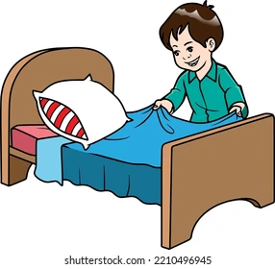
Luke 11:27
As he said these things, a woman in the crowd raised her voice and said to him, “Blessed is the womb that bore you, and the breasts at which you nursed!”
Luke 11:28
But he said,
“Blessed rather are those
who HEAR the word of God
and KEEP it!”

Slide 30
SUMMARY
Prayer is exercising of our faith in submitting to and depending on who God is in His Person, who has His own sovereign Plan and Purpose.
Prayer is a challenge to our willingness to know God as a Person especially through His word and thus to obey Him.
Prayer is not just a seeking of our needs, let alone our wants. It is about seeking God Himself.
The true disciple who learn to pray will always learn to receive and obey God’s Word”.

