Slide 1
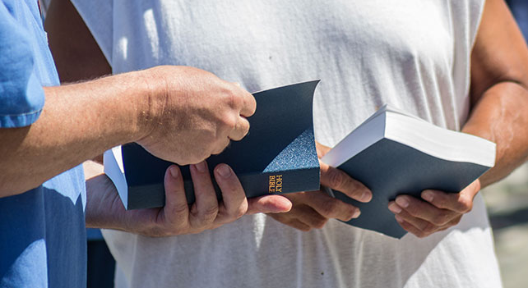
Luke 10:1-24
Gospel Preached and Received

Slide 2
Luke 10:1-24
Gospel Preached and Received
The message of God's kingdom
must be preached and received
1. Jesus instructed the seventy two as he sent them out (10:1-12)
Those who reject will face severe judgement (10:12-16)
2. Jesus rejoiced with the seventy two when they returned (10:17-20)
Those who accept are greatly blessed (10:21-24)

Slide 3
Luke 10
¹ After this the Lord appointed seventy-two others and sent them on ahead of him,
two by two, into every town and place where he himself was about to go.
² And he said to them,
“The harvest is plentiful, but the laborers are few.
Therefore pray earnestly to the Lord of the harvest to send out laborers
into his harvest.
³ Go your way; behold, I am sending you out as lambs in the midst of wolves.

Slide 4
Luke 10
⁴ Carry no moneybag, no knapsack, no sandals, and greet no one on the road.”
⁵ “Whatever house you enter, first say, ‘Peace be to this house!’
⁶ And if a son of peace is there, your peace will rest upon him.
But if not, it will return to you.
⁷ And remain in the same house, eating and drinking what they provide,
for the laborer deserves his wages. Do not go from house to house.
⁸ Whenever you enter a town and they receive you, eat what is set before you.
⁹ Heal the sick in it and say to them, ‘The kingdom of God has come near to you.’
¹⁰ But whenever you enter a town and they do not receive you,
go into its streets and say,
¹¹ ‘Even the dust of your town that clings to our feet we wipe off against you.
Nevertheless know this, that the kingdom of God has come near.’
¹² I tell you, it will be more bearable on that day for Sodom than for that town.”

Slide 5
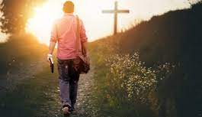
Luke 10:1-24
Gospel Preached and Received
The message of God's kingdom
must be preached and received
Stay focused on what
God would have us do,
not what we prefer
(He’ll protect & provide)

Slide 6
Luke 10
⁵ “Whatever house you enter, first say, ‘Peace be to this house!’
⁶ And if a son of peace is there, your peace will rest upon him.
But if not, it will return to you.
⁷ And remain in the same house, eating and drinking what they provide,
for the laborer deserves his wages. Do not go from house to house.
⁸ Whenever you enter a town and they receive you, eat what is set before you.
⁹ Heal the sick in it and say to them, ‘The kingdom of God has come near
to you.’
¹⁰ But whenever you enter a town and they do not receive you,
go into its streets and say,
¹¹ ‘Even the dust of your town that clings to our feet we wipe off against you.
Nevertheless know this, that the kingdom of God has come near.’

Slide 7
Luke 10
¹² “I tell you, it will be more bearable on that day for Sodom than for that town.
¹³ Woe to you, Chorazin!
Woe to you, Bethsaida!
For if the mighty works done in you had been done in Tyre and Sidon,
they would have repented long ago, sitting in sackcloth and ashes.
¹⁴ But it will be more bearable in the judgment for Tyre and Sidon than for you.
¹⁵ And you, Capernaum, will you be exalted to heaven?
You shall be brought down to Hades.
¹⁶ The one who hears you hears me,
and the one who rejects you rejects me,
and the one who rejects me rejects him who sent me.”

Slide 8

Luke 10:1-24
Gospel Preached and Received
The message of God's kingdom
must be preached and received
Stay focused on what
God would have us do,
not what we prefer
(He’ll protect & provide)
We must recognize
how varied people’s
responses can be

Slide 9
Luke 10
¹⁷ The seventy-two returned with joy, saying,
“Lord, even the demons are subject to us in your name!”
¹⁸ And he said to them,
“I saw Satan fall like lightning from heaven.
¹⁹ Behold, I have given you authority to tread on serpents and scorpions,
and over all the power of the enemy, and nothing shall hurt you.
²⁰ Nevertheless, do not rejoice in this, that the spirits are subject to you,
but rejoice that your names are written in heaven.”
c.f. Gen 3:15
I will put enmity between you and the woman,
and between your offspring and her offspring;
he shall bruise your head,
and you shall bruise his heel.

Slide 10
Luke 10
¹⁷ The seventy-two returned with joy, saying,
“Lord, even the demons are subject to us in your name!”
¹⁸ And he said to them,
“I saw Satan fall like lightning from heaven.
¹⁹ Behold, I have given you authority to tread on serpents and scorpions,
and over all the power of the enemy, and nothing shall hurt you.
²⁰ Nevertheless, do not rejoice in this, that the spirits are subject to you,
but rejoice that your names are written in heaven.”
c.f. Gen 3:15
I will put enmity between you and the woman,
and between your offspring and her offspring;
he shall bruise your head,
and you shall bruise his heel.

Slide 11
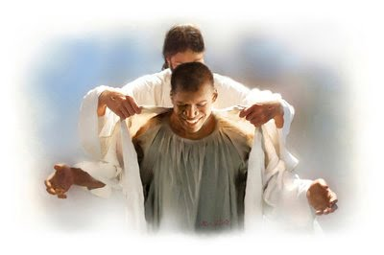
Luke 10:1-24
Gospel Preached and Received
The message of God's kingdom
must be preached and received
Be glad about what
God has done for us,
not what we can do
or have done

Slide 12
Luke 10
²¹ In that same hour he rejoiced in the Holy Spirit and said,
“I thank you, Father, Lord of heaven and earth,
that you have hidden these things from the wise and understanding and
revealed them to little children; yes, Father, for such was your gracious will.
²² All things have been handed over to me by my Father,
and no one knows who the Son is except the Father,
or who the Father is except the Son
and anyone to whom the Son chooses to reveal him.”
²³ Then turning to the disciples he said privately,
“Blessed are the eyes that see what you see!
²⁴ For I tell you that many prophets and kings desired
to see what you see, and did not see it,
and to hear what you hear, and did not hear it.”

Slide 13
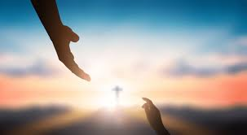
Luke 10:1-24
Gospel Preached and Received
The message of God's kingdom
must be preached and received
Be glad about what
God has done for us,
not what we can do
or have done
We must remember
how privileged we are
as God’s children

Slide 14
Luke 10:1-24
Gospel Preached and Received
The message of God's kingdom
must be preached and received
Stay focused on what
God would have us do,
not what we prefer
(He’ll protect & provide)
We must recognize
how varied people’s
responses can be
Be glad about what
God has done for us,
not what we can do
or have done
We must remember
how privileged we are
as God’s children

