Slide 1
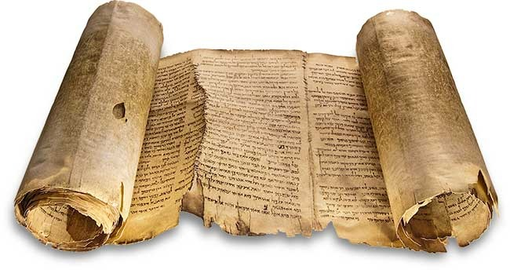
Staying True
Jude 1-25

Slide 2
“The greatest cause of atheism in the world today is Christians who acknowledge Jesus with their lips but deny him by their lifestyle. That is what the
unbelieving world finds unbelievable”
“I really enjoy all of your religious posts on Facebook. Ever consider modifying your behaviour to match them?”
“Going to church doesn't make you a Christian any more than going to a garage makes you a car.”
“I like your Christ, I do not like your Christians.
Your Christians are so unlike your Christ.” - Gandhi

Slide 3
Jude 1:3-4
3 Beloved, although I was very eager to write to you
about our common salvation,
I found it necessary to write appealing to you
to contend for the faith
that was once for all delivered to the saints.
4 For certain people have crept in unnoticed
who long ago were designated for this condemnation,
ungodly people,
who pervert the grace of our God into sensuality
& deny our only Master & Lord, Jesus Christ.

Slide 4
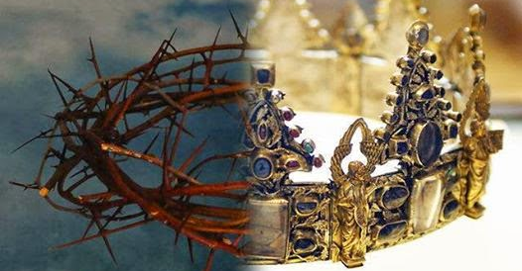
Influence (Environment) Then & Now
Godly living & God as King
are not taken seriously

Slide 5
One Basic Key Truth
Instruction 1
Four Key Ideas
Key Idea 1
Key Idea 3
Key Idea 2
Key Idea 4
Three Key
Instructions
Instruction 2
Instruction 3

Slide 6
Jude 1:5-7
5 Now I want to remind you, although you once fully knew it,
that Jesus, who saved a people out of the land of
Egypt, afterward destroyed those who did not believe
6 And the angels who did not stay within their own
position of authority, but left their proper dwelling,
he has kept in eternal chains under gloomy darkness
until the judgment of the great day -
7 just as Sodom & Gomorrah & the surrounding cities,
which likewise indulged in sexual immorality & pursued
unnatural desire, serve as an example by undergoing a
punishment of eternal fire.

Slide 7
Jude 1:11
Woe to them!
For they walked in the way of Cain & abandoned
themselves for the sake of gain to Balaam's error
& perished in Korah's rebellion.

Slide 8

1:5-16
a. Problem from
past to present

Slide 9
Jude 1:8-10
8 Yet in like manner these people also, relying on their dreams
defile the flesh, reject authority,
& blaspheme the glorious ones.
9 But when the archangel Michael, contending with the devil,
was disputing about the body of Moses, he did not presume
to pronounce a blasphemous judgment, but said, "The Lord
rebuke you."
10 But these people blaspheme all that they do not
understand & they are destroyed by all that they,
like unreasoning animals, understand instinctively.

Slide 10
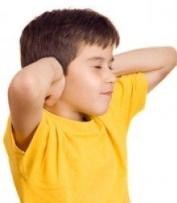
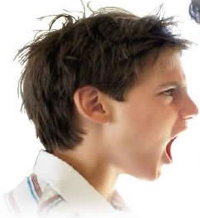
1:5-16
a. Problem from
past to present
b. Disregard &
disrespect

Slide 11
Jude 1:12-13
12 These are blemishes on your love feasts,
as they feast with you without fear,
looking after themselves;
waterless clouds, swept along by winds;
fruitless trees in late autumn, twice dead,
uprooted;
13 wild waves of the sea,
casting up the foam of their own shame;
wandering stars, for whom the gloom of utter
darkness has been reserved forever.

Slide 12
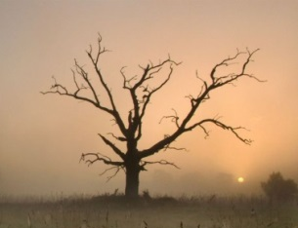

1:5-16
a. Problem from
past to present
b. Disregard &
disrespect
c. Not true to its
design/purpose

Slide 13
“We cannot pray in love & live in hate & still think we are worshipping God.
Let us suppose we are back in the days of the high priest, who took
incense & went behind the veil & offered it. And let us suppose that
rubber had been available in those days. Let us suppose that chips of
rubber had been mixed with the incense, so that instead of the pure
smoke of the spices filling the temple with sweet perfume, there had
been the black, angry, rancid smell of rubber mixed in it. How could a
priest worship God by mixing with the sweet smelling ingredients some
foul ingredient that would be a stench in the nostrils of priest & people?
So how can we worship God acceptably when there is within our nature something that, when it catches fire, gives off not a fragrance but a smell? How can we hope to worship God acceptably when there is something in our nature which is undisciplined, uncorrected, unpurged, unpurified – which is evil & which will not & cannot worship God acceptably?”
A.W. Tozer

Slide 14
Jude 1:5-7
5 Now I want to remind you, although you once fully knew it,
that Jesus, who saved a people out of the land of Egypt,
afterward destroyed those who did not believe
6 And the angels who did not stay within their own
position of authority, but left their proper dwelling,
he has kept in eternal chains under gloomy darkness
until the judgment of the great day -
7 just as Sodom & Gomorrah & the surrounding cities,
which likewise indulged in sexual immorality & pursued
unnatural desire, serve as an example by undergoing a
punishment of eternal fire.

Slide 15
Jude 1:11, 14-15
11 Woe to them!
For they walked in the way of Cain & abandoned
themselves for the sake of gain to Balaam's error
& perished in Korah's rebellion.
14 It was also about these that Enoch,
the seventh from Adam, prophesied, saying,
"Behold, the Lord came with ten thousands
of his holy ones,
to execute judgment on all & to convict all
the ungodly of all their deeds of ungodliness…"

Slide 16
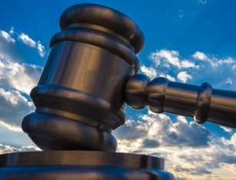
1:5-16
a. Problem from
past to present
b. Disregard &
disrespect
c. Not true to its
design/purpose
d. Sure judgment
in the future

Slide 17
Jude 1:3-4
3 Beloved, although I was very eager to write to you
about our common salvation,
I found it necessary to write appealing to you
to contend for the faith
that was once for all delivered to the saints.
4 For certain people have crept in unnoticed
who long ago were designated for this condemnation,
ungodly people,
who pervert the grace of our God into sensuality
& deny our only Master & Lord, Jesus Christ.

Slide 18
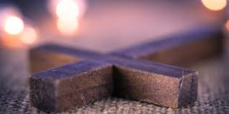
1. Keep true
to the Christian Faith
1:3-4
1:5-16
a. Problem from
past to present
c. Not true to its design/purpose
b. Disregard
& disrespect
d. Sure judgment
in the future

Slide 19
Religious faith
When the circumstances in my
life go wrong, I am angry at God
or myself
When I am criticized, I am furious or devastated, because it is critical that I feel good about myself
My prayer life consists largely of petition, & I pray when I am in need. My main purpose is control.
Gospel centred faith
When circumstances in my life go wrong, I struggle, but I know that God may allow this for my training
When I am criticized, I struggle, but my identity is built on God’s love for me in Christ.
My prayer life consists also of praise & adoration. My main purpose is fellowship with God.
Extracted from Tim Keller’s “Religion vs Gospel”

Slide 20
Religious faith
My self-view swings between two poles. When I am living up to my standards, I feel confident, I tend to be proud & unsympathetic to failing people. When I am not up to standard, I feel like a failure.
My identity & self-worth are based mainly on how hard I work, or how good I am - & I tend look down
on those I perceive as lazy or immoral.
Gospel centred faith
My self-view is based on Christ.
I am sinful & lost, yet accepted in Christ. I am so bad & I am so loved that he died for me. He is why
I am humble & confident at
the same time.
My identity & self-worth
are centered on Jesus who died
for me. I am saved by grace so
I can’t look down on others.
Only by grace am I what I am.
Extracted from Tim Keller’s “Religion vs Gospel”

Slide 21
Jude 1:17-23
17 But you must remember, beloved, the predictions of the apostles of our Lord Jesus Christ. 18 They said to you, "In the last time there will be scoffers, following their own ungodly passions." 19 It is these who cause divisions, worldly people, devoid of the Spirit.
20 But you, beloved, build yourselves up in your most holy faith; pray in the Holy Spirit; 21 keep yourselves in the love of God, waiting for the mercy of our Lord Jesus Christ that leads to eternal life.

Slide 22
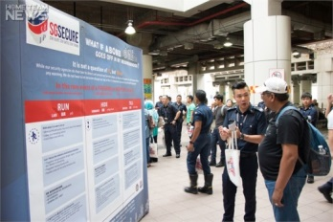
1. Keep true
to the Christian Faith
1:3-4
1:5-16
a. Problem from
past to present
c. Not true to its design/purpose
b. Disregard
& disrespect
d. Sure judgment
in the future
2. Keep watch
against subtle bad influences
1:17-23

Slide 23
Jude 1:17-23
20 But you, beloved,
build yourselves up in your most holy faith;
pray in the Holy Spirit;
21 keep yourselves in the love of God,
waiting for the mercy of our Lord Jesus Christ
that leads to eternal life.
22 And have mercy on those who doubt;
23 save others by snatching them out of the fire;
to others show mercy with fear,
hating even the garment stained by the flesh.

Slide 24

1. Keep true
to the Christian Faith
1:3-4
1:5-16
a. Problem from
past to present
c. Not true to its design/purpose
b. Disregard
& disrespect
d. Sure judgment
in the future
2. Keep watch
against subtle bad influences
3. Keep firm
in our faith, His love & prayer
1:17-23

Slide 25
Jude 1:1-2, 24-25
1 Jude, a servant of Jesus Christ & brother of James,
To those who are called, beloved in God the Father
& kept for Jesus Christ:
2 May mercy, peace, & love be multiplied to you.
24 Now to him who is able to keep you from stumbling
& to present you blameless before the presence of his
glory with great joy,
25 to the only God, our Savior, through Jesus Christ our Lord,
be glory, majesty, dominion, & authority, before all time &
now & forever. Amen.

Slide 26
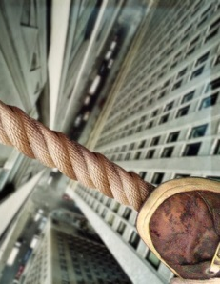
1:1-2
We are called, loved & kept;
1. Keep true
to the Christian Faith
1:3-4
1:5-16
a. Problem from
past to present
b. Disregard &
disrespect
c. Not true to its
design/purpose
d. Sure judgment
in the future
2. Keep watch
against subtle bad influences
3. Keep firm
in our faith, His love & prayer
1:17-23
1:24-25
God is The Keeper of our souls

Slide 27
1:1-2
We are called, loved & kept;
1. Keep true
to the Christian Faith
1:3-4
1:5-16
a. Problem from
past to present
b. Disregard &
disrespect
c. Not true to its
design/purpose
d. Sure judgment
in the future
2. Keep watch
against subtle bad influences
3. Keep firm
in our faith, His love & prayer
1:17-23
1:24-25
God is The Keeper of our souls

