Slide 1

Things Are Not
Looking Up
Hosea 7:1-16

Slide 2
Hos 6:1
Come, let us return to the Lord; for he has torn us, that he may heal us; he has struck us down, and he will bind us up.
Hos 6:6
For I desire steadfast love and not
sacrifice, the knowledge of God
rather than burnt offerings.
Hos 6:7
But like Adam they transgressed the
covenant; there they dealt faithlessly
with me.
Israel professed to return to the Lord & expected Him to heal
God restated what
He desires & values
God explained where
& how they have failed

Slide 3
Hos 6:1
Come, let us return to the Lord; for he has torn us, that he may heal us; he has struck us down, and he will bind us up.
Hos 6:6
For I desire steadfast love and not
sacrifice, the knowledge of God
rather than burnt offerings.
Hos 6:7
But like Adam they transgressed the
covenant; there they dealt faithlessly
with me.
Hos 7:10
The pride of Israel testifies to his face; yet they do not return to the Lord their God, nor seek him, for all this.
Hos 7:14, 16
They do not cry to me from the heart …They return, but not upward

Slide 4
Things Are Not
Looking Up
Hosea 7:1-16
1. Israel failed to seize the opportunities to turn back (7:1-2)
2. Israel failed to see the seriousness of their sins (7:3-9)
3. Israel failed to seal off influences that were bad (7:10-12)
4. Israel failed to seek the Lord with their hearts (7:13-16)

Slide 5
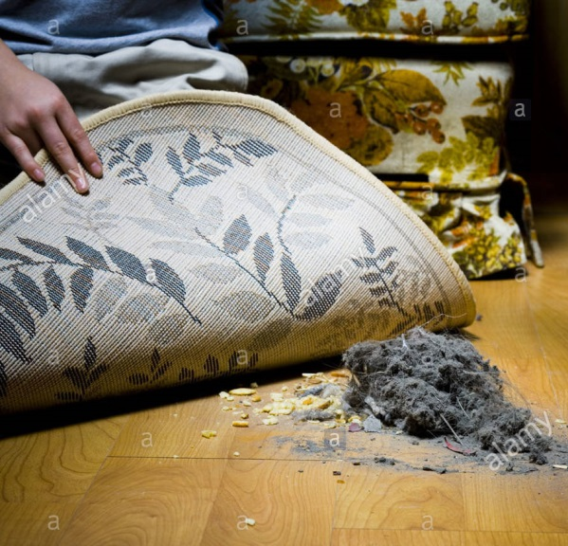
1. Israel failed to seize the opportunities to turn back (7:1-2)
6:11 When I restore the fortunes of my people
7:1 when I would heal Israel,
the iniquity of Ephraim is revealed,
and the evil deeds of Samaria,
for they deal falsely;
the thief breaks in,
and the bandits raid outside.
2 But they do not consider
that I remember all their evil.
Now their deeds surround them;
they are before my face.

Slide 6

1. Israel failed to seize the opportunities to turn back (7:1-2)
Things are not looking up when…
The
LORD
God
We don’t seize the opportunities to turn back

Slide 7
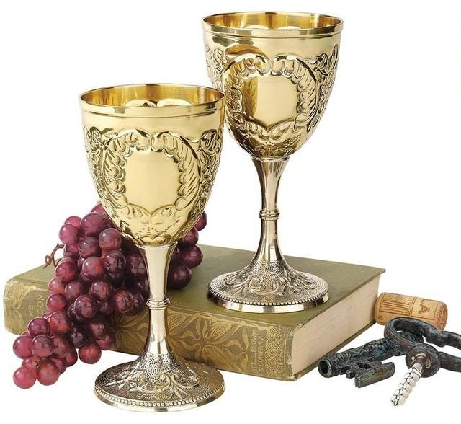
2. Israel failed to see the seriousness of their sins (7:3-9)
3 By their evil they make the king glad,
and the princes by their treachery.
5 On the day of our king,
the princes became sick with the heat of wine;
he stretched out his hand with mockers.
7 All of them are hot as an oven,
and they devour their rulers.
All their kings have fallen,
and none of them calls upon me

Slide 8
2. Israel failed to see the seriousness of their sins (7:3-9)
c.f. 2 Kings
And he (Jeroboam) did that which was evil in the sight of the Lord (14:24)
…Zachariah his son reigned in his stead (14:29)
And he did that which was evil in the sight of the Lord, (15:9)
And Shallum the son of Jabesh conspired against him, & smote him
before the people, & slew him, & reigned in his stead. (15:10)
For Menahem the son of Gadi…smote Shallum the son of Jabesh
in Samaria, & slew him, & reigned in his stead. (15:14)
And he did that which was evil in the sight of the Lord: (15:18)

Slide 9
2. Israel failed to see the seriousness of their sins (7:3-9)
c.f. 2 Kings
And he (Pekahiah) did that which was evil in the sight of the Lord: (15:24)
But Pekah the son of Remaliah, a captain of his, conspired against
him, & smote him in Samaria…& he killed him, & reigned in his
room. (15:25)
And he did that which was evil in the sight of the Lord: (15:28)
And Hoshea the son of Elah made a conspiracy against Pekah the son
of Remaliah, & smote him, & slew him, & reigned in his stead, (15:30)
And he did that which was evil in the sight of the Lord, (17:2)

Slide 10
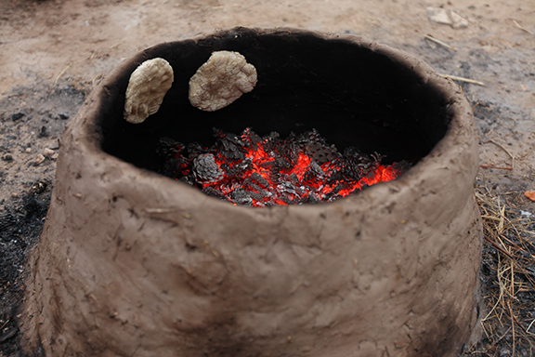
2. Israel failed to see the seriousness of their sins (7:3-9)
4 They are all adulterers; they are like a heated oven
whose baker ceases to stir the fire,
from the kneading of the dough until it is leavened.
6 For with hearts like an oven
they approach their intrigue;
all night their anger smolders;
in the morning
it blazes like a flaming fire.
7 All of them are hot as an oven,
and they devour their rulers.

Slide 11

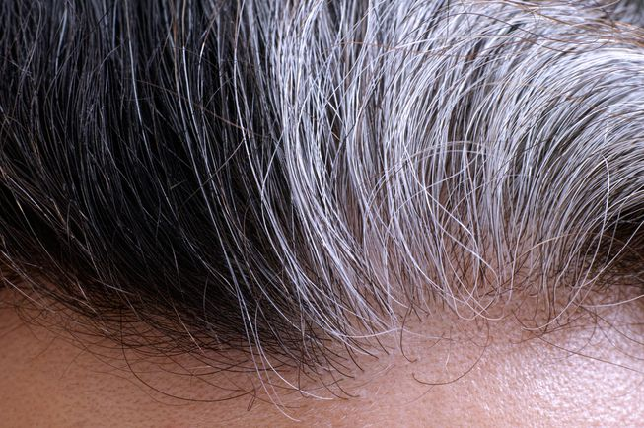
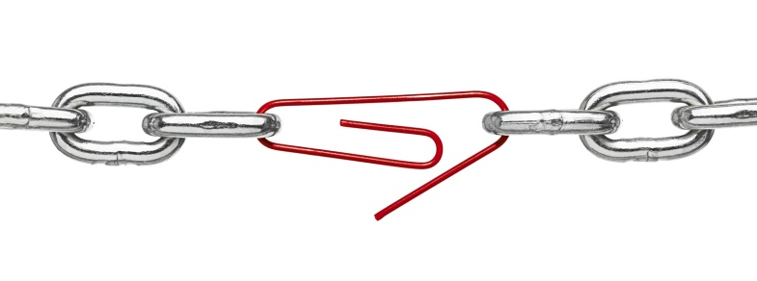
2. Israel failed to see the seriousness of their sins (7:3-9)
8 Ephraim mixes himself with the peoples;
Ephraim is a cake not turned.
9 Strangers devour his strength,
and he knows it not;
gray hairs are sprinkled upon him,
and he knows it not.

Slide 12
2. Israel failed to see the seriousness of their sins (7:3-9)
Things are not looking up when…
The
LORD
God
We don’t see the seriousness of our sins

Slide 13

3. Israel failed to seal off influences that were bad (7:10-12)
c.f. 8 Ephraim mixes himself with the peoples;
Ephraim is a cake not turned.
11 Ephraim is like a dove,
silly and without sense,
calling to Egypt, going to Assyria.
12 As they go, I will spread over them my net;
I will bring them down like birds of the heavens;
I will discipline them according to the report
made to their congregation.

Slide 14
c.f. 2 Kings 17:3-6
3 Against him came up Shalmaneser king of Assyria. And Hoshea (king
of Israel) became his vassal and paid him (king of Assyria) tribute.
4 But the king of Assyria found treachery in Hoshea (king of Israel),
for he had sent messengers to So, king of Egypt, and offered no
tribute to the king of Assyria, as he had done year by year. Therefore
the king of Assyria shut him up and bound him in prison.
5 Then the king of Assyria invaded all the land and came to Samaria,
and for three years he besieged it.
6 In the ninth year of Hoshea, the king of Assyria captured Samaria, and
he carried the Israelites away to Assyria and placed them in Halah, and
on the Habor, the river of Gozan, and in the cities of the Medes.
3. Israel failed to seal off influences that were bad (7:10-12)

Slide 15
3. Israel failed to seal off influences that were bad (7:10-12)
c.f. 8 Ephraim mixes himself with the peoples;
Ephraim is a cake not turned.
11 Ephraim is like a dove,
silly and without sense,
calling to Egypt, going to Assyria.
12 As they go, I will spread over them my net;
I will bring them down like birds of the heavens;
I will discipline them according to the report
made to their congregation.

Slide 16
3. Israel failed to seal off influences that were bad (7:10-12)
Things are not looking up when…
The
LORD
God
We don’t seal off the influences that are bad

Slide 17
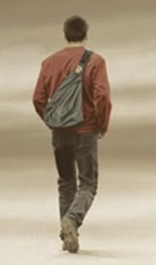
4. Israel failed to seek the Lord with their hearts (7:13-16)
13 Woe to them, for they have strayed from me!
Destruction to them, for they have rebelled against me!
14 They do not cry to me from the heart,
but they wail upon their beds;
…they rebel against me.
16 They return, but not upward…
c.f. 10 The pride of Israel testifies to his face; yet they do not return
to the Lord their God, nor seek him, for all this.
c.f. 6:1 Come, let us return to the Lord…

Slide 18
4. Israel failed to seek the Lord with their hearts (7:13-16)
Things are not looking up when…
The
LORD
God
We don’t seek the Lord with our hearts

Slide 19
Things are not looking up…
We are not
turning back
We are being
influenced
The
LORD
God
Hosea 7
We are not having
a change of heart
We are taking
sin lightly

Slide 20
Things are not looking up…
Things will start looking up when we keep looking up
We are not
turning back
We are being
influenced
Seize the opportunity
to turn back
Seal off influences
that are bad
The
LORD
God
Hosea 7
We are not having
a change of heart
We are taking
sin lightly
Seek the Lord
with our hearts
See the seriousness of our sins

