Slide 1
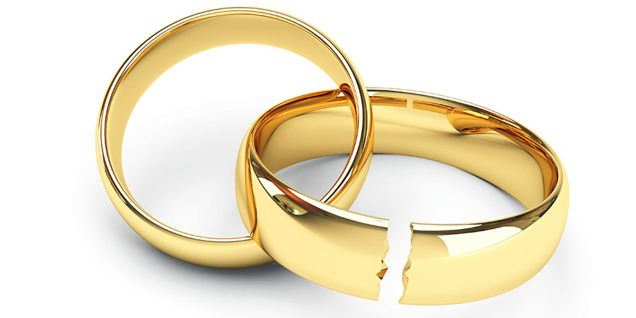
When an Unfaithful People
Face The Faithful God
Hosea 1:1-2:1

Slide 2
Israel’s
Context
Prosperity,
Complacency,
Infidelity
Pre-exile
Exile
Post-exile
Jeroboam II
(793-753 BC)
Assyrian
(722 BC)
Israel
Hosea
Babylonian
(586 BC)
Division
(931 BC)
Judah
Uzziah
(792-740 BC)
Hosea 1:1
The word of the Lord that came
to Hosea, the son of Beeri,
in the days of Uzziah, Jotham,
Ahaz, & Hezekiah, kings of Judah,
& in the days of Jeroboam the
son of Joash, king of Israel.
Jotham
(750-732 BC)
Ahaz
(735-716 BC)
Hezekiah
(716-687 BC)

Slide 3
Hosea
Israel’s rebellion will bring God’s severe retribution but God’s love & mercy will bring about restoration

Slide 4
When an Unfaithful People
Face The Faithful God
Hosea 1:1-2:1
1. Setting (1:1)
2. God instructed Hosea to
take Gomer as wife (1:2-3)
3. God instructed Hosea to name
His children accordingly (1:4-9)
4. God promised to restore Israel (1:10-2:1)

Slide 5
2. God instructed Hosea to take Gomer as wife (1:2-3)
2 When the Lord first spoke through Hosea, the Lord said to Hosea, “Go, take to yourself a wife of whoredom and have children of whoredom, for the land commits great whoredom
by forsaking the Lord.”
3 So he went and took Gomer, the daughter of Diblaim, and she conceived and bore him a son..

Slide 6
2. God instructed Hosea to take Gomer as wife (1:2-3)
Hosea
marries
Gomer
“whoredom”

Slide 7
Cheating truly is a choice…
Throughout the whole time, I wasn’t in his mind, not even for a second. In those moments I didn’t exist as far as he was concerned.
The time, the effort, the spectacular lengths
he went to so that he could keep me in the dark.
He chose to do this.

Slide 8
Anyone can say he loves you,
yet very few genuinely do. Actions reflect the truth, words can be twisted to alter our reality. Respect is everything in all relationships, & if your partner has cheated on you then they obviously do not respect you at all because if they did, they wouldn’t ever have cheated in the first place.

Slide 9
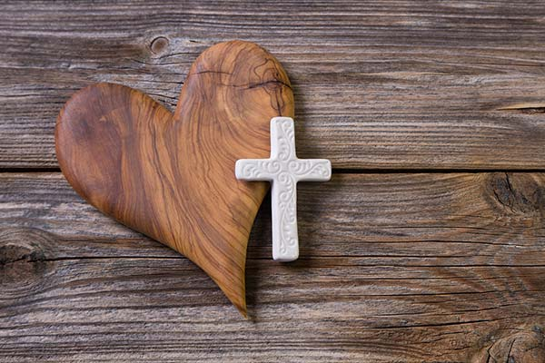
2. God instructed Hosea to take Gomer as wife (1:2-3)
Faithful
God
Unfaithful
People
Hosea
marries
Gomer
“whoredom”
Truth 1: We dethrone God & become unfaithful when He isn’t our first love anymore

Slide 10
Idolatry truly is a choice…
Throughout the whole time, God wasn’t in our mind, not even for a second. In those moments
He didn’t exist as far as we’re concerned.
The time, the effort, the spectacular lengths
we went to so that we could keep God in the dark.
We chose to do this.
Cheating truly is a choice…
Throughout the whole time, I wasn’t in his mind, not even for a second. In those moments I didn’t exist as far as he was concerned.
The time, the effort, the spectacular lengths
he went to so that he could keep me in the dark.
He chose to do this.

Slide 11
Anyone can say they love God, yet very few genuinely do. Actions reflect the truth, words can be twisted to alter our reality. Respect is everything in all relationships, & if we have idols in our hearts, then we obviously do not respect God
at all because if we did, we wouldn’t ever
want idols in the first place.

Slide 12
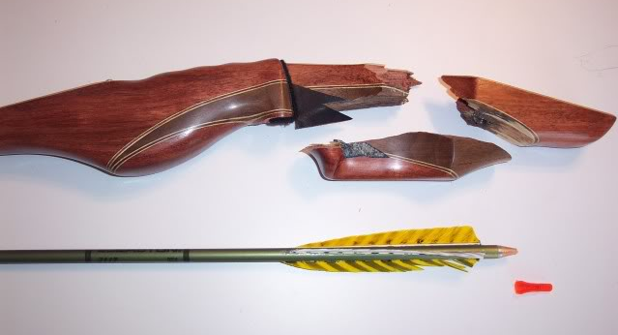
3. God instructed Hosea to name His children (1:4-9)
4 And the Lord said to him, “Call his name Jezreel, for in just a little while I will punish the house of Jehu for the blood of Jezreel, and I will put an end to the kingdom of the house of Israel. rael.
5 And on that day I will break the
bow of Israel in the Valley of
Jezreel.”

Slide 13
3. God instructed Hosea to name His children (1:4-9)
c.f. 2 Kings 10:11, 28-29
11 So Jehu struck down all who remained of the house of Ahab in Jezreel, all his great men and his close friends and his priests, until he left him none remaining.
28 Thus Jehu wiped out Baal from Israel.
29 But Jehu did not turn aside from the sins of Jeroboam the son of Nebat, which he made Israel to sin - that is, the golden calves that were in Bethel and in Dan.

Slide 14
3. God instructed Hosea to name His children (1:4-9)
6 She conceived again and bore a daughter.
And the Lord said to him, “Call her name
No Mercy, for I will no more have mercy
on the house of Israel, to forgive them at all.”
8 When she had weaned No Mercy, she conceived and bore a son. 9 And the Lord said, “Call his name Not My People, for you are not my people, and I am not your God.”

Slide 15
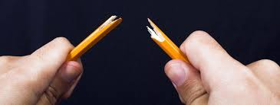
3. God instructed Hosea to name His children (1:4-9)
Faithful
God
Unfaithful
People
Hosea
breeds
Gomer
Jezreel
No Mercy
Not My People
“Bloodshed”
Truth 2: Our relationship with God is destroyed when we are unfaithful

Slide 16
Why Learn the Hard Way?
Why don’t we learn from our mistakes & then do our
best to avoid them? Some people fail to learn because
of ego. Others are too busy, stubborn, angry, disappointed, embarrassed, or just plain lazy.

Slide 17
“I already know” Some think they know a lot already
“It’ll never happen again.” Some think it may
not occur again - even though it probably will
“There’s nothing that can be done” Some think
most failures are beyond their control - so it is pointless.
“I’m seldom that wrong.” Some believe they don’t
make mistakes; hence, they’ll never learn.

Slide 18
“It’s always been like that” Some do things
without much thinking
“People don’t understand” Some avoid feedback;
if they don’t know about their flaws, they don’t have any.
“It looks OK to me” Some convince themselves
it’s not a mistake.
“Don’t make me be like you” Some refuse to
consider whether something’s been done before

Slide 19
3. God instructed Hosea to name His children (1:4-9)
7 But I will have mercy on the house of Judah, and I will save them by the Lord their God. I will not save them by bow or by sword or by war or by horses or by horsemen.
Truth 2: Our relationship with God is destroyed when we are unfaithful

Slide 20
4. God promised to restore Israel (1:10-2:1)
11 And the children of Judah and the children of Israel shall be gathered together, and they shall appoint for themselves one head. And they shall go up from the land, for great shall be the day of Jezreel.
2:1 Say to your brothers, “You are my people,”
and to your sisters, “You have received mercy.”

Slide 21
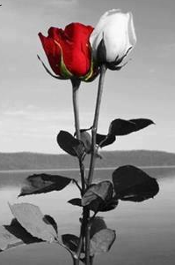
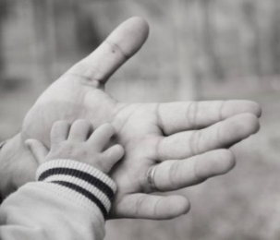
4. God promised to restore Israel (1:10-2:1)
Faithful
God
Unfaithful
People
Bloodshed
No Mercy
Not My People
Great day
Shown Mercy
My People

Slide 22
4. God promised to restore Israel (1:10-2:1)
10 Yet the number of the children of Israel shall be like the sand of the sea, which cannot be measured or numbered. And in the place where it was said to them, “You are not my people,” it shall be said to them, “Children of the living God.” 11 And the children of Judah and the children of Israel shall be gathered together, and they shall appoint for themselves one head. And they shall go up from the land, for great shall be the day of Jezreel.

Slide 23
4. God promised to restore Israel (1:10-2:1)
c.f. Romans 9
24 even us whom he has called, not from the Jews only but also from the Gentiles? 25 As indeed he says in Hosea, “Those who were not my people
I will call ‘my people,’ and her who was not beloved I will call ‘beloved.’” 26 “And in the very place where it was said to them, ‘You are not my people,’ there they will be called ‘sons of the living God.’”

Slide 24
4. God promised to restore Israel (1:10-2:1)
c.f. 1 Peter 2
5 5 you yourselves like living stones are being built up as a spiritual house, to be a holy priesthood, to offer spiritual sacrifices acceptable to God through Jesus Christ.
10 Once you were not a people, but now you are God's people; once you had not received mercy, but now you have received mercy.

Slide 25
4. God promised to restore Israel (1:10-2:1)
Faithful
God
Unfaithful
People
Bloodshed
No Mercy
Not My People
Great day
Shown Mercy
My People

Slide 26
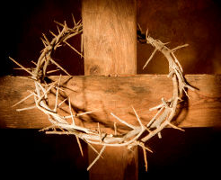
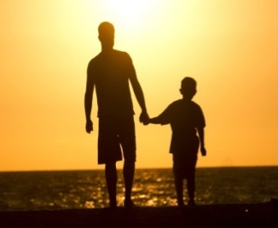
4. God promised to restore Israel (1:10-2:1)
Faithful
God
Unfaithful
People
Great day
Shown Mercy
My People
Truth 3: We are delivered from judgment through Christ because our God is faithful

Slide 27

When an Unfaithful People
Face The Faithful God
Hosea 1:1-2:1
Truth 1:
Dethronement
↓
Our Unfaithfulness
Truth 3:
God’s Faithfulness
↓
Deliverance
Truth 2:
Our Unfaithfulness
↓
Destruction

Slide 28
Grace
Laura Story
My heart is so proud; my mind is so unfocused.
I see the things You do through me
as great things I have done.
And now You gently break me, then lovingly You take me
And hold me as my father & mold me as my maker.

Slide 29
At times I may grow weak & feel a bit discouraged,
knowing that someone,
somewhere could do a better job.
For who am I to serve You? I know I don't deserve You.
And that's the part that burns in my heart
& keeps me hanging on.

Slide 30
[Chorus]
I ask you: "How many times will you pick me up,
when I keep on letting you down?
And each time I will fall short of Your glory,
how far will forgiveness abound?"
And You answer: " My child, I love you.
And as long as you're seeking My face,
you'll walk in the power of My daily sufficient grace."

Slide 31
As I walk with You,
I'm learning what Your grace really means.
The price that I could never pay was paid at Calvary.
So, instead of trying to repay You,
I'm learning to simply obey You,
By giving up my life to you
For all that You've given to me.

