Slide 1
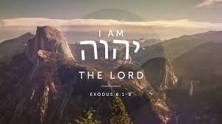
Exodus 6: The Re-Commission of Moses
I am the Lord.
I will redeem you.
I will take you as my own people
I will be your God.
– Exodus 6:6-7

Slide 2
Exodus 6: The Re-Commission of Moses
Outline of Book of Exodus:
1. God's plan for deliverance (Exodus 1-15)
- The Exodus – God’s Power
2. God's principles for holy living (Exodus 16–24)
- The Sinai Covenant – God’s Principles
3. God's pattern for worship and fellowship (Exodus 25–40)
- The Tabernacle – God’s Presence

Slide 3
Exodus 6: The Re-Commission of Moses
Backdrop of 3 events in Exodus 5.
the defiance of Pharaoh (Exodus 5:2).
^{Exodus 5:2} Pharaoh said, “Who is the Lord, that I should obey him and let Israel go? I do not know the Lord and I will not let Israel go.”
2. the denunciation of Moses by the Hebrews (Exodus 5:20-21).
^{Exodus 5:20} When they left Pharaoh, they found Moses and Aaron waiting to meet them, ²¹ and they said, “May the Lord look on you and judge you! You have made us obnoxious to Pharaoh and his officials and have put a sword in their hand to kill us.”
3. the doubts and discouragement of Moses (Exodus 5:22-23).
^{Exodus 5:22} Moses returned to the Lord and said, “Why, Lord, why have you brought trouble on this people? Is this why you sent me? ²³ Ever since I went to Pharaoh to speak in your name, he has brought trouble on this people, and you have not rescued your people at all.”

Slide 4
Exodus 6: The Re-Commission of Moses
Outline of Exodus 6: The Affirmation of Moses’ Commission
1. The sovereignty of God (Exodus 6:1-5)
2. The purpose of God (Exodus 6:6-8)
3. The dejection of the people (Exodus 6:9-12)
4. The legitimacy of Moses’ commission (Exodus 6:13-27)

Slide 5
Exodus 6: The Re-Commission of Moses
The sovereignty of God (Exodus 6:1-5)
^{Exodus 5:2} Pharaoh said, “Who is the Lord, that I should obey him and let Israel go? I do not know the Lord and I will not let Israel go.”
Exodus 6:1-5 is God’s response to Pharaoh’s defiance.
1. The sovereignty of God (Exodus 6:1-5)
a. God asserts His sovereignty (Exodus 6:1)
b. God affirms His power (Exodus 6:2-3)
c. God remembers His covenant (Exodus 6:4-5)

Slide 6
Exodus 6: The Re-Commission of Moses
The sovereignty of God (Exodus 6:1-5)
a. God asserts His sovereignty (Exodus 6:1)
It is foolish to challenge or defy God
^{Exodus 6:1} the Lord said to Moses, “Now you will see what I will do to Pharaoh: Because of my mighty hand he will let them go”.
^{Exodus 6:1c} Because of my mighty hand he will drive them out of his country.
NLT - In fact, he will force them to leave his land!
^{Exodus 3:19} But I know that the king of Egypt will not let you go unless a mighty hand compels him. ²⁰ So I will stretch out my hand and strike the Egyptians with all the wonders that I will perform among them. After that, he will let you go.

Slide 7
Exodus 6: The Re-Commission of Moses
Exodus 6: The Re-Commission of Moses
1. The sovereignty of God (Exodus 6:1-5)
a. God asserts His sovereignty (Exodus 6:1)
^{Isaiah 43:12} I am God.¹³ Yes, and from ancient days I am he. No one can deliver out of my hand. When I act, who can reverse it?”
^{Job 23:13} “But he stands alone, and who can oppose him? He does whatever he pleases.
^{Proverbs 21:30} There is no wisdom, no insight, no plan that can succeed against the Lord.
He is the Sovereign God.
When you fight God, you lose.

Slide 8
Exodus 6: The Re-Commission of Moses
Exodus 6: The Re-Commission of Moses
1. The sovereignty of God (Exodus 6:1-5)
a. God asserts His sovereignty (Exodus 6:1)
b. God affirms His power (Exodus 6:2-3)
God progressively reveals Himself through His many Names.
The Names of God reveals who God is.
1. Jehovah Nissi (The Lord My Banner).
2. Jehovah-Raah (The Lord My Shepherd).
3. Jehovah Rapha (The Lord That Heals).
4. Jehovah Shammah (The Lord Is There).
5. Jehovah Sabaoth (The Lord of Hosts).
6. Jehovah Tsidkenu (The Lord Our Righteousness).
7. Jehovah Mekoddishkem (The Lord Who Sanctifies You).
8. Jehovah Jireh (The Lord Will Provide).
9. Jehovah Shalom (The Lord Is Peace).
10. El Elyon (The Most High God).

Slide 9
Exodus 6: The Re-Commission of Moses
^{Exodus 6:2} God also said to Moses, “I am the Lord.
Hebrew transliterated: YHWH = the LORD
the tetragrammaton.
His personal name - Yahweh or Jehovah
means ^{Exodus 3:14} “I am who I am”
the eternal, self-sufficient, pre-existent, self-existent,
all encompassing, and without limitations, the only Sovereign Being in the universe who is not dependent on something else for his existence.

Slide 10
Exodus 6: The Re-Commission of Moses
^{Exodus 6:3 (NLT)} I appeared to Abraham, to Isaac, and to Jacob as El-Shaddai—‘God Almighty’—but I did not reveal my name, Yahweh, to them.
El Shaddai – 6X in Genesis 17:1, 28:3; 35:11; 43:14; 48:3; 49:25.

Slide 11
Exodus 6: The Re-Commission of Moses
“El” = Hebrew word for God.
Shaddai = mountain—representing God’s strength.
= breast—where a child receives nourishment.
“El-Shaddai” = the all-powerful and all-sufficient God who can
do anything and meet any need.
= a very powerful God who can accomplish
impossible things.

Slide 12
Exodus 6: The Re-Commission of Moses
What is your impossible situation?
God works in the impossible.
God is sufficient for whatever we are going through right now!
^{Philippians 4:19} My God will meet all your needs according to the riches of his glory in Christ Jesus. We need to experience that ²
^{Corinthians 12:9} “[His] grace is sufficient for me, for [His] power is made perfect in [my] weakness.
God reminds US of who He is:
^{Exodus 6:2} I am the Lord. I am YHWH
^{Exodus 3:14} “I am who I am”
^{Exodus 6:3} I am El Shaddai = God Almighty.

Slide 13
Exodus 6: The Re-Commission of Moses
Exodus 6: The Re-Commission of Moses
1. The sovereignty of God (Exodus 6:1-5)
a. God asserts His sovereignty (Exodus 6:1)
b. God affirms His power (Exodus 6:2-3)
c. God remembers His covenant (Exodus 6:4-5)
^{Exodus 6:4} I also established my covenant with them to give them the land of Canaan, where they resided as foreigners.
⁵ Moreover, I have heard the groaning of the Israelites, whom the Egyptians are enslaving, and I have remembered my covenant.

Slide 14
Exodus 6: The Re-Commission of Moses
Exodus 6: The Re-Commission of Moses
1. The sovereignty of God (Exodus 6:1-5)
2. The purpose of God for freeing the Hebrews (Exodus 6:6-8)
What is God’s plan and purpose for Israel?
^{Exodus 6:} ⁶ “Therefore, say to the Israelites: ‘I am the Lord, and I will bring you out from under the yoke of the Egyptians. I will free you from being slaves to them, and I will redeem you (literally - ‘I will act the redeemer-kinsman’ or gō’ēl.) with an outstretched arm and with mighty acts of judgment. ⁷ I will take you as my own people, and I will be your God. Then you will know that I am the Lord your God, who brought you out from under the yoke of the Egyptians. ⁸ And I will bring you to the land I swore with uplifted hand to give to Abraham, to Isaac and to Jacob. I will give it to you as a possession. I am the Lord.’”

Slide 15
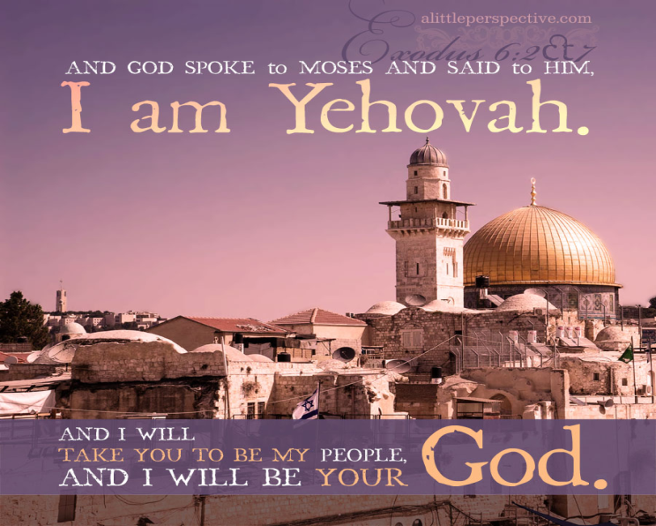
Exodus 6: The Re-Commission of Moses
I am the Lord.
I will redeem you.
I will take you as my own people
I will be your God.
– Exodus 6:6-7
the heart of the book of Exodus (the Bible)
the very heart of God.

Slide 16
Exodus 6: The Re-Commission of Moses
Exodus 6: The Re-Commission of Moses
1. The sovereignty of God (Exodus 6:1-5)
2. The purpose of God for freeing the Hebrews (Exodus 6:6-8)
3. The dejection of the people (Exodus 6:9-12)
^{Exodus 6: 9} Moses reported this to the Israelites, but they did not listen to him because of their discouragement and harsh labor.
Contrast their initial response
^{Exodus 4:29} Moses and Aaron brought together all the elders of the Israelites,
³⁰ and Aaron told them everything the Lord had said to Moses. He also performed the signs before the people, ³¹ and they believed. And when they heard that the Lord was concerned about them and had seen their misery, they bowed down and worshiped.

Slide 17
Exodus 6: The Re-Commission of Moses
Exodus 3 was the 1st call.
^{Exodus 3:10} So now, go. I am sending you to Pharaoh to bring my people the Israelites out of Egypt.”
Exodus 6 is the recall.
^{Exodus 6:10} Then the Lord said to Moses,¹¹ “Go, tell Pharaoh king of Egypt to let the Israelites go out of his country.”

Slide 18
Exodus 6: The Re-Commission of Moses
Moses’ response to the reccommission:
^{Exodus 6:12} But Moses said to the Lord, “If the Israelites will not listen to me, why would Pharaoh listen to me, since I speak with faltering lips?”
Moses
- he did not have the gifts or the ability to do what God was calling him to do.

Slide 19
Exodus 6: The Re-Commission of Moses
the challenge of leadership:
- challenge of people’s following
– what good is a leader if no one wants to follow?
challenge of leader’s confidence
– how effective is a leader who is not gifted or
does not have the capacity to lead well.

Slide 20
Exodus 6: The Re-Commission of Moses
God wanted you to do something in this church.
- You say you are not qualified.
- Are you on the verge of giving up?
Serving the Lord is so discouraging that
it is tempting to just walk away.

Slide 21
Exodus 6: The Re-Commission of Moses
^{Exodus 7:1} Then the Lord said to Moses, “See, I have made you like God to Pharaoh, and your brother Aaron will be your prophet. ² You are to say everything I command you, and your brother Aaron is to tell Pharaoh to let the Israelites go out of his country. ³ But I will harden Pharaoh’s heart, and though I multiply my signs and wonders in Egypt, ⁴ he will not listen to you. Then I will lay my hand on Egypt and with mighty acts of judgment I will bring out my divisions, my people the Israelites. ⁵ And the Egyptians will know that I am the Lord when I stretch out my hand against Egypt and bring the Israelites out of it.”

Slide 22
Exodus 6: The Re-Commission of Moses
Exodus 6:2-8 – 4x, “I am the Lord” (vv. 2, 6, 7, 8)
- 7x, God said, “I will.”
^{Exodus 6:2} God also said to Moses, “I am the Lord. ³ I appeared to Abraham, to Isaac and to Jacob as God Almighty, but by my name the Lord I did not make myself fully known to them. ⁴ I also established my covenant with them to give them the land of Canaan, where they resided as foreigners. ⁵ Moreover, I have heard the groaning of the Israelites, whom the Egyptians are enslaving, and I have remembered my covenant. ⁶ “Therefore, say to the Israelites: ‘I am the Lord, and I will bring you out from under the yoke of the Egyptians. I will free you from being slaves to them, and I will redeem you with an outstretched arm and with mighty acts of judgment. ⁷ I will take you as my own people, and
I will be your God. Then you will know that I am the Lord your God, who brought you out from under the yoke of the Egyptians. ⁸ And I will bring you to the land I swore with uplifted hand to give to Abraham, to Isaac and to Jacob.
I will give it to you as a possession. I am the Lord.’”

Slide 23
Exodus 6: The Re-Commission of Moses
We are saved to serve.
What is God calling you to do or to keep on doing?
“I am the LORD.”
“I am the El Shaddai, the God Almighty. “
→ trust him and obey him.

Slide 24
Exodus 6: The Re-Commission of Moses
Exodus 6: The Re-Commission of Moses
1. The sovereignty of God (Exodus 6:1-5)
2. The purpose of God for freeing the Hebrews (Exodus 6:6-8)
3. The dejection of the people (Exodus 6:9-12)
4. The legitimacy of Moses’ commission (Exodus 6:13-27)
What do we do with the many genealogical records in the Bible ?
1 Chronicles 1-9, Matthew 1:1-17, Luke 3:23-38
God carries out his plans and purposes through real people living in the real world
God cares about history, about families, about individuals.
God uses imperfect people to carry out his plans and to fulfil his purposes.

Slide 25
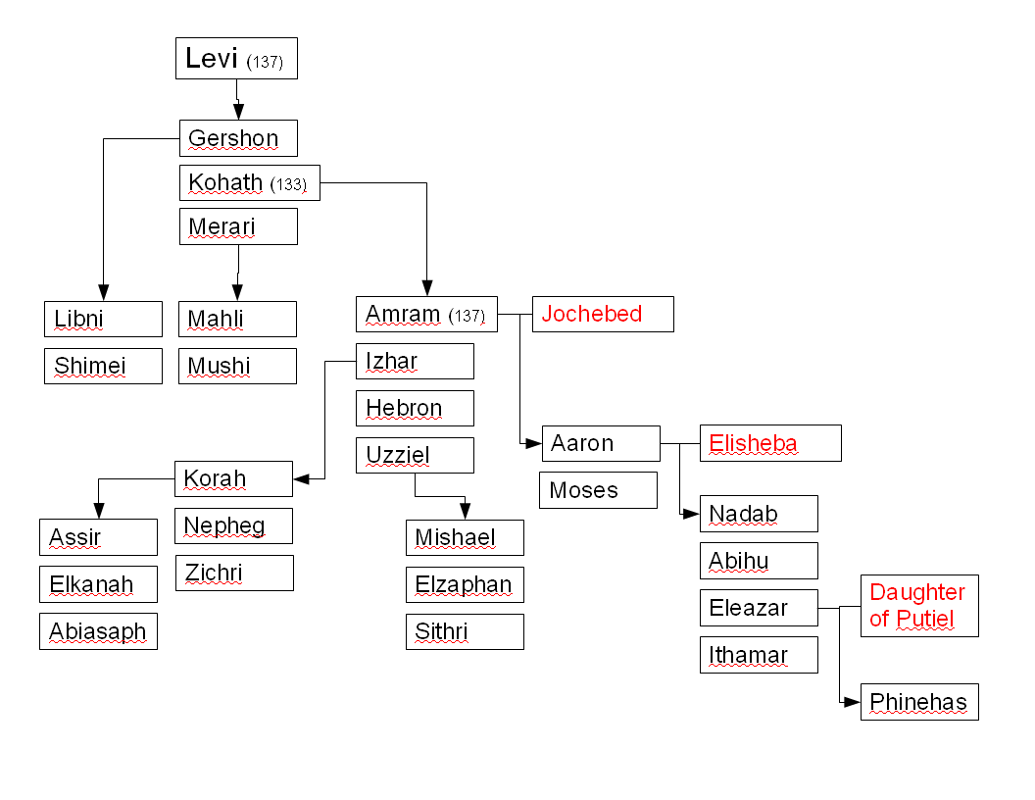
Exodus 6: The Re-Commission of Moses

Slide 26
Exodus 6: The Re-Commission of Moses
^{Jeremiah 1:5} Before I formed you in the womb I knew you, before you were born I set you apart; I appointed you as a prophet to the nations.
God’s calling means God’s enabling.
What He begins God completes.
^{Philippians 1:6 (NLT)} And I am certain that God, who began the good work within you, will continue his work until it is finally finished on the day when Christ Jesus returns.

Slide 27
Exodus 6: The Re-Commission of Moses
^{Psalms 33:10} The Lord foils the plans of the nations; he thwarts the purposes of the peoples. ¹¹ But the plans of the Lord stand firm forever, the purposes of his heart through all generations.
¹² Blessed is the nation whose God is the Lord, the people he chose for his inheritance. ¹³ From heaven the Lord looks down and sees all mankind; ¹⁴ from his dwelling place he watches all who live on earth—
¹⁸ But the eyes of the Lord are on those who fear him, on those whose hope is in his unfailing love, ²⁰ We wait in hope for the Lord; he is our help and our shield. ²¹ In him our hearts rejoice, for we trust in his holy name. ²² May your unfailing love be with us, Lord, even as we put our hope in you.

