Slide 1
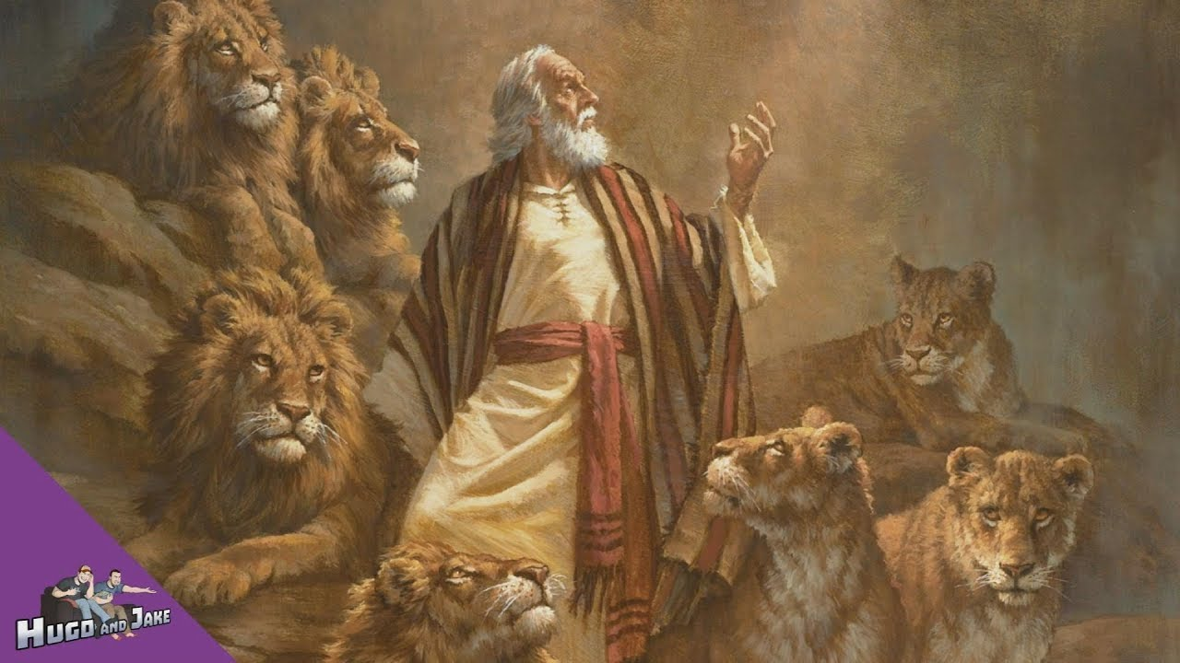
Daniel 6:1-28
Daniel in the Lion’s Den

Slide 2
Daniel 6
Outline of Daniel 6:1-28 Daniel in the Lions’ Den
(or Liars, Laws and Lions)
1. Daniel Promoted (Daniel 6:1-5)
2. Daniel Persecuted/Plotted Against (Daniel 6:6-9)
3. Daniel Prayed (Daniel 6:10-11)
4. Daniel Punished (Daniel 6:12-18)
5. Daniel Protected (Daniel 6:19-24)
6. Daniel’s God Praised (Daniel 6:25-28)

Slide 3
Daniel 6
Daniel 5:³⁰ That very night Belshazzar, king of the Babylonians, was slain, ³¹ and Darius the Mede took over the kingdom.
Daniel 6:¹ It pleased Darius to appoint 120 satraps to rule throughout the kingdom, ² with three administrators over them, one of whom was Daniel. The satraps were made accountable to them so that the king might not suffer loss.

Slide 4
Daniel 6
What kind of person was Daniel?
1. Daniel was a man who gave his very best (Daniel 6:3, Daniel 5:10-12)
Daniel 6: ³ so distinguished himself among the administrators and the satraps by his exceptional qualities that the king planned to set him over the whole kingdom.

Slide 5
Daniel 6
Daniel 5: ¹⁰ The queen (mother, NIV text note), hearing the voices of the king and his nobles, came into the banquet hall. “May the king live forever!” she said. “Don’t be alarmed! Don’t look so pale! ¹¹ There is a man in your kingdom who has the spirit of the holy gods in him. In the time of your father he was found to have insight and intelligence and wisdom like that of the gods. Your father, King Nebuchadnezzar, appointed him chief of the magicians, enchanters, astrologers and diviners. ¹² He did this because Daniel, whom the king called Belteshazzar, was found to have a keen mind and knowledge and understanding, and also the ability to interpret dreams, explain riddles and solve difficult problems.

Slide 6
Daniel 6
Jeremiah 29:^{7 (NLT)}
And work for the peace and prosperity of the city where I sent you into exile.
Pray to the Lord for it, for its welfare will determine your welfare.

Slide 7
Daniel 6
Ephesians 6: ^{(NLT) 5} Slaves, obey your earthly masters with deep respect and fear. Serve them sincerely as you would serve Christ. ⁶ Try to please them all the time, not just when they are watching you. As slaves of Christ, do the will of God with all your heart. ⁷ Work with enthusiasm, as though you were working for the Lord rather than for people.
⁸ Remember that the Lord will reward each one of us for the good we do, whether we are slaves or free.

Slide 8
Daniel 6
What kind of person was Daniel?
1. Daniel was a man who gave his very best (Daniel 6:3, Daniel 5:10-12)
2. Daniel was a person of unassailable integrity (Daniel 6:4-5)
Daniel 6: ⁴ At this, the administrators and the satraps tried to find grounds for charges against Daniel in his conduct of government affairs, but they were unable to do so. They could find no corruption in him, because he was trustworthy and neither corrupt nor negligent.

Slide 9
Daniel 6
2 Timothy 3:¹² In fact, everyone who wants to live a godly life in Christ Jesus will be persecuted.

Slide 10
Daniel 6
What kind of person was Daniel?
1. Daniel was a man who gave his very best (Daniel 6:3, Daniel 5:10-12)
2. Daniel was a person of unassailable integrity (Daniel 6:4-5)
3. Daniel was a diligent student of the Bible (Daniel 6:5)

Slide 11
Daniel 6
Daniel 9:​¹ In the first year of Darius son of Xerxes (a Mede by descent), who was made ruler over the Babylonian kingdom— ² in the first year of his reign, I, Daniel, understood from the Scriptures, according to the word of the Lord given to Jeremiah the prophet, that the desolation of Jerusalem would last seventy years. ³ So I turned to the Lord God and pleaded with him in prayer and petition, in fasting, and in sackcloth and ashes
Jeremiah 25:11-12 and Jeremiah 29:10-14.

Slide 12
Daniel 6
Daniel 6:⁵ Finally these men said, “We will never find any basis for charges against this man Daniel unless it has something to do with the law of his God.”

Slide 13
Daniel 6
Daniel 6: ⁶ So these administrators and satraps went as a group to the king and said: “May King Darius live forever! ⁷ The royal administrators, prefects, satraps, advisers and governors have all agreed that the king should issue an edict and enforce the decree that anyone who prays to any god or human being during the next thirty days, except to you, Your Majesty, shall be thrown into the lions’ den. ⁸ Now, Your Majesty, issue the decree and put it in writing so that it cannot be altered—in accordance with the law of the Medes and Persians, which cannot be repealed.” ⁹ So King Darius put the decree in writing.

Slide 14
Daniel 6
What kind of person was Daniel?
1. Daniel was a man who gave his very best (Daniel 6:3, Daniel 5:10-12)
2. Daniel was a person of unassailable integrity (Daniel 6:4-5)
3. Daniel was a diligent student of the Bible (Daniel 6:5)
4. Daniel was a man of prayer (Daniel 6:10).

Slide 15
Daniel 6
Daniel 6:¹⁰ Now when Daniel learned that the decree had been published, he went home to his upstairs room where the windows opened toward Jerusalem. Three times a day he got down on his knees and prayed, giving thanks to his God, just as he had done before. ¹¹ Then these men went as a group and found Daniel praying and asking God for help.

Slide 16
Daniel 6
Daniel 6:^{10b (NLT)} He prayed three times a day, just as he had always done.

Slide 17
Daniel 6
Romans 13: (NLT) ¹ Everyone must submit to governing authorities. For all authority comes from God, and those in positions of authority have been placed there by God.
² So anyone who rebels against authority is rebelling against what God has instituted, and they will be punished.
³ For the authorities do not strike fear in people who are doing right, but in those who are doing wrong. Would you like to live without fear of the authorities? Do what is right, and they will honor you.
⁴ The authorities are God’s servants, sent for your good. But if you are doing wrong, of course you should be afraid, for they have the power to punish you. They are God’s servants, sent for the very purpose of punishing those who do what is wrong.
⁵ So you must submit to them, not only to avoid punishment, but also to keep a clear conscience.

Slide 18
Daniel 6
Summary: Why obey government?
1. God is the one who has appointed the government (Romans 13:1).
2. If we disobey, we will be disobeying God’s instituted authority, and we will be judged. (Romans 13:2).
3. If we disobey, the government will punish us (Romans 13:3).
4. It is the right thing to do (Romans 13:5).

Slide 19
Daniel 6
Mark 12:17
"Give to Caesar what is Caesar's
and to God what is God's."

Slide 20
Daniel 6
Acts 5:²⁹ “We must obey God rather than human beings!

Slide 21
Daniel 6
Give to Caesar what is Caesar's
1. submit to the governing authorities (Romans 13:1-7, Titus 3:1-2)
Titus 3: ^{1.} Remind the people to be subject to rulers and authorities, to be obedient, to be ready to do whatever is good, ^{2.} to slander no-one, to be peaceable and considerate, and to show true humility towards all men.

Slide 22
Daniel 6
Give to Caesar what is Caesar's
1. submit to the governing authorities (Romans 13:1-7, Titus 3:1-2)
2. seek the peace and prosperity of the country (Jeremiah 29:7)
Jeremiah 29: ⁷Also, seek the peace and prosperity of the city to which I have carried you into exile. Pray to the LORD for it, because if it prospers, you too will prosper."

Slide 23
Daniel 6
Give to Caesar what is Caesar's
1. submit to the governing authorities (Romans 13:1-7, Titus 3:1-2)
2. seek the peace and prosperity of the country (Jeremiah 29:7)
3. Pray for the government leaders (1 Timothy 2:1-4)
1 Timothy 2: ^{1.} I urge, then, first of all, that requests, prayers, intercession and thanksgiving be made for everyone-- ^{2.} for kings and all those in authority, that we may live peaceful and quiet lives in all godliness and holiness. ^{3.} This is good, and pleases God our Saviour, ^{4.} who wants all men to be saved and to come to a knowledge of the truth.

Slide 24
Daniel 6
Give to Caesar what is Caesar's
1. submit to the governing authorities (Romans 13:1-7, Titus 3:1-2)
2. seek the peace and prosperity of the country (Jeremiah 29:7)
3. Pray for the government leaders (1 Timothy 2:1-4)
4. Set a good example and be a testimony to the non-Christians (1 Peter 2:13-17)
1 Peter 2: ^{13.} Submit yourselves for the Lord's sake to every authority instituted among men: whether to the king, as the supreme authority, ^{14.} or to governors, who are sent by him to punish those who do wrong and to commend those who do right. ^{15.} For it is God's will that by doing good you should silence the ignorant talk of foolish men. ^{16.} Live as free men, but do not use your freedom as a cover-up for evil; live as servants of God. ^{17.} Show proper respect to everyone: Love the brotherhood of believers, fear God, honour the king.

