Slide 1
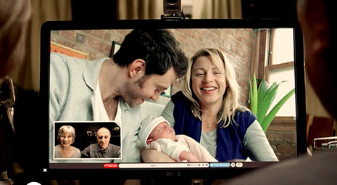
Alone & Yet Never Alone
2 Timothy 4:9-22

Slide 2
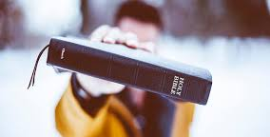

2 Timothy
(1:3-2:13)
Don’t be
ashamed
to suffer for
the gospel
(2:14-26)
Teach &
pursue
truth with
integrity
(3:1-4:8)
Continue in
your ministry
despite
opposition

Slide 3
2 Tim 4:9-22
9 Do your best to come to me soon.
10 For Demas, in love with this present world, has deserted me & gone to Thessalonica.
Crescens has gone to Galatia, Titus to Dalmatia.
11 Luke alone is with me.
Get Mark & bring him with you,
for he is very useful to me for ministry.
12 Tychicus I have sent to Ephesus.
13 When you come, bring the cloak that I left with Carpus at Troas, also the books, & above all the parchments.
14 Alexander the coppersmith did me great harm;
the Lord will repay him according to his deeds.
15 Beware of him yourself, for he strongly opposed our message.
16 At my first defense no one came to stand by me, but all deserted me.
May it not be charged against them!
17 But the Lord stood by me & strengthened me, so that through me the message might be fully proclaimed
& all the Gentiles might hear it. So I was rescued from the lion's mouth.
18 The Lord will rescue me from every evil deed & bring me safely into his heavenly kingdom.
To him be the glory forever & ever. Amen.
19 Greet Prisca & Aquila, & the household of Onesiphorus.
20 Erastus remained at Corinth, & I left Trophimus, who was ill, at Miletus.
21 Do your best to come before winter.
Eubulus sends greetings to you, as do Pudens & Linus & Claudia & all the brothers.
22 The Lord be with your spirit. Grace be with you.

Slide 4
Alone & Yet Never Alone
2 Timothy 4:9-22
1. Paul instructed Timothy to come to him soon (4:9, 21)
explaining that he was left alone (4:9-13),
opposed & abandoned (4:14-16),
but yet strengthened by God (4:17-18);
2. Paul sent his greetings to fellow brothers (4:19-22)

Slide 5
Background
(One possible re-construction of 2 Timothy)
He was re-arrested
at Troas
He continued his missionary work
Paul was released from house arrest (in Acts 28)
(Winter
coming
soon)
A pre-trial took place
in Rome
He’s waiting
for final trial
in confinement
(He knew his death would
be imminent)
Timothy’s
likely in Ephesus
“Come quickly”
(with Mark)

Slide 6
9 Do your best to come to me soon.
10 For Demas, in love with this present world, has deserted me
& gone to Thessalonica. Crescens has gone to Galatia,
11 Titus to Dalmatia. Luke alone is with me.
Get Mark & bring him with you, for he is very useful to me for ministry.
12 Tychicus I have sent to Ephesus. 13 When you come, bring the cloak
that I left with Carpus at Troas, also the books, & above all the
parchments.
Luke the beloved physician greets you, as does Demas (Col 4:14)
Epaphras, my fellow prisoner in Christ Jesus, sends greetings
to you, & so do Mark, Aristarchus, Demas, & Luke, my fellow workers (Phm 23-24)

Slide 7
9 Do your best to come to me soon.
10 For Demas, in love with this present world, has deserted me
& gone to Thessalonica. Crescens has gone to Galatia,
11 Titus to Dalmatia. Luke alone is with me.
Get Mark & bring him with you, for he is very useful to me for ministry.
12 Tychicus I have sent to Ephesus. 13 When you come, bring the
cloak that I left with Carpus at Troas, also the books, & above all
the parchments.
Tychicus will tell you all about my activities…I have sent him to you for this very purpose, that you may know how we are (Col 4:7-8)
Tychicus…will tell you everything. I have sent him to you for this very purpose, that you may know how we are (Eph 6:21-22)

Slide 8
9 Do your best to come to me soon.
10 For Demas, in love with this present world, has deserted me
& gone to Thessalonica. Crescens has gone to Galatia,
11 Titus to Dalmatia. Luke alone is with me.
Get Mark & bring him with you, for he is very useful to me for ministry.
12 Tychicus I have sent to Ephesus. 13 When you come, bring the
cloak that I left with Carpus at Troas, also the books, & above all
the parchments.
20 Erastus remained at Corinth, & I left Trophimus, who was ill,
at Miletus.

Slide 9
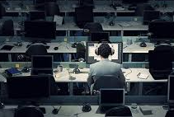
Paul explained he was left alone (4:9-13)
i. There are those who left for worldly reasons
ii. There are those who left for ministry reasons
iii. There are those who left for personal reasons
As we serve the Lord,
Be prepared to be left alone

Slide 10
Background
(One possible re-construction of 2 Timothy)
He was re-arrested
at Troas
He continued his missionary work
Paul was released from house arrest (in Acts 28)
(Winter
coming
soon)
A pre-trial took place
in Rome
He’s waiting
for final trial
in confinement
(He knew his death would
be imminent)
Timothy’s
likely in Ephesus
“Come quickly”
(with Mark)

Slide 11
14 Alexander the coppersmith did me great harm;
the Lord will repay him according to his deeds.
15 Beware of him yourself, for he strongly opposed our message.
16 At my first defense no one came to stand by me,
but all deserted me. May it not be charged against them!
…holding faith & a good conscience. By rejecting this,
some have made shipwreck of their faith, among whom
are Hymenaeus & Alexander, whom I have handed
over to Satan that they may learn not to blaspheme.
(1 Tim 1:19-20)

Slide 12
14 Alexander the coppersmith did me great harm;
the Lord will repay him according to his deeds.
15 Beware of him yourself, for he strongly opposed our message.
16 At my first defense no one came to stand by me,
but all deserted me. May it not be charged against them!
…holding faith & a good conscience. By rejecting this,
some have made shipwreck of their faith, among whom
are Hymenaeus & Alexander, whom I have handed
over to Satan that they may learn not to blaspheme.
(1 Tim 1:19-20)

Slide 13
14 Alexander the coppersmith did me great harm;
the Lord will repay him according to his deeds.
15 Beware of him yourself, for he strongly opposed our message.
16 At my first defense no one came to stand by me,
but all deserted me. May it not be charged against them!

Slide 14
14 Alexander the coppersmith did me great harm;
the Lord will repay him according to his deeds.
15 Beware of him yourself, for he strongly opposed our message.
16 At my first defense no one came to stand by me,
but all deserted me. May it not be charged against them!

Slide 15
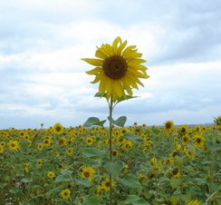
Paul explained he was opposed & abandoned (4:14-16)
i. He faced oppositions, hurts & betrayals
ii. He looked to the Lord to exercise His judgment
& asked Timothy to exercise discernment
iii. He resisted resentment
As we serve the Lord,
Be prepared to stand alone

Slide 16
Background
(One possible re-construction of 2 Timothy)
He was re-arrested
at Troas
He continued his missionary work
Paul was released from house arrest (in Acts 28)
(Winter
coming
soon)
A pre-trial took place
in Rome
He’s waiting
for final trial
in confinement
(He knew his death would
be imminent)
Timothy’s
likely in Ephesus
“Come quickly”
(with Mark)

Slide 17
17 But the Lord stood by me & strengthened me, so that through
me the message might be fully proclaimed & all the Gentiles
might hear it. So I was rescued from the lion's mouth.
18 The Lord will rescue me from every evil deed & bring me safely
into his heavenly kingdom. To him be the glory forever & ever.
Amen.
19 Greet Prisca & Aquila, & the household of Onesiphorus.
20 Erastus remained at Corinth, & I left Trophimus, who was ill, at Miletus.
21 Do your best to come before winter. Eubulus sends greetings to you,
as do Pudens & Linus & Claudia & all the brothers.
22 The Lord be with your spirit. Grace be with you.

Slide 18
17 But the Lord stood by me & strengthened me, so that through
me the message might be fully proclaimed & all the Gentiles
might hear it. So I was rescued from the lion's mouth.
18 The Lord will rescue me from every evil deed & bring me safely
into his heavenly kingdom. To him be the glory forever & ever.
Amen.
19 Greet Prisca & Aquila, & the household of Onesiphorus.
20 Erastus remained at Corinth, & I left Trophimus, who was ill, at Miletus.
21 Do your best to come before winter. Eubulus sends greetings to you,
as do Pudens & Linus & Claudia & all the brothers.
22 The Lord be with your spirit. Grace be with you.

Slide 19
17 But the Lord stood by me & strengthened me, so that through
me the message might be fully proclaimed & all the Gentiles
might hear it. So I was rescued from the lion's mouth.
18 The Lord will rescue me from every evil deed & bring me safely
into his heavenly kingdom. To him be the glory forever & ever.
Amen.
19 Greet Prisca & Aquila, & the household of Onesiphorus.
20 Erastus remained at Corinth, & I left Trophimus, who was ill, at Miletus.
21 Do your best to come before winter. Eubulus sends greetings to you,
as do Pudens & Linus & Claudia & all the brothers.
22 The Lord be with your spirit. Grace be with you.

Slide 20
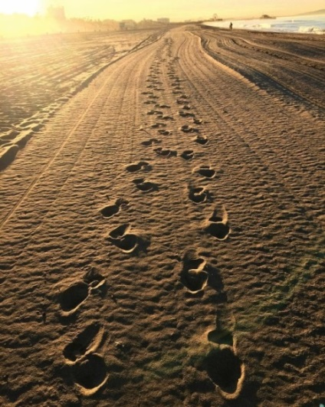
Paul explained he was strengthened by God (4:17-18)
i. God strengthened him to advance the gospel
ii. God rescued him & would keep his soul safe
iii. God would be present & gracious to Timothy too
As we serve the Lord,
Be assured of God’s company

Slide 21
19 Greet Prisca & Aquila, & the household of Onesiphorus.
20 Erastus remained at Corinth, & I left Trophimus, who was ill, at Miletus.
21 Do your best to come before winter. Eubulus sends greetings to you, as do Pudens & Linus & Claudia & all the brothers.
22 The Lord be with your spirit. Grace be with you.
9 Do your best to come to me soon.
11 Luke alone is with me. Get Mark & bring him with you,
for he is very useful to me for ministry.

Slide 22
19 Greet Prisca & Aquila, & the household of Onesiphorus.
20 Erastus remained at Corinth, & I left Trophimus, who was ill, at Miletus.
21 Do your best to come before winter. Eubulus sends greetings to you, as do Pudens & Linus & Claudia & all the brothers.
22 The Lord be with your spirit. Grace be with you.
9 Do your best to come to me soon.
11 Luke alone is with me. Get Mark & bring him with you,
for he is very useful to me for ministry.
But Paul thought best not to take with them one (Mark) who had with-drawn from them in Pamphylia & had not gone with them (Acts 15:38)
…if he (Mark) comes to you, welcome him (Col 4:10)

Slide 23
19 Greet Prisca & Aquila, & the household of Onesiphorus.
20 Erastus remained at Corinth, & I left Trophimus, who was ill, at Miletus.
21 Do your best to come before winter. Eubulus sends greetings to you, as do Pudens & Linus & Claudia & all the brothers.
22 The Lord be with your spirit. Grace be with you.
9 Do your best to come to me soon.
11 Luke alone is with me. Get Mark & bring him with you,
for he is very useful to me for ministry.
(Onesiphorus)…often refreshed me & was not ashamed of my chains, but when he arrived in Rome he searched for me earnestly & found
me - may the Lord grant him to find mercy from the Lord on that Day! - & you well know all the service he rendered at Ephesus. (2 Tim 1:16-18)

Slide 24
19 Greet Prisca & Aquila, & the household of Onesiphorus.
20 Erastus remained at Corinth, & I left Trophimus, who was ill, at Miletus.
21 Do your best to come before winter. Eubulus sends greetings to you, as do Pudens & Linus & Claudia & all the brothers.
22 The Lord be with your spirit. Grace be with you.
9 Do your best to come to me soon.
11 Luke alone is with me. Get Mark & bring him with you,
for he is very useful to me for ministry.

Slide 25

Paul greeted his fellow brothers (4:19-22 c.f. 11-13)
i. There were those would be there for him
ii. There were those who were helpful to his ministry
iii. There were many who were co-workers elsewhere
As we serve the Lord,
Be assured of good company

Slide 26
Alone & Yet Never Alone
2 Timothy 4:9-22
As we serve the Lord,
a. i. Be prepared to be left alone (4:9-13)
ii. Be prepared to stand alone (4:14-16)
b. i. Be assured of God’s company (4:17-18)
ii. Be assured of good company (4:11-13, 19-22)
How do the presence of problems & the absence of friends affect
how we serve God? How can we still press on to serve Him faithfully?

